Slide 1

Palm Sunday
25th Mar 2018

Slide 2
⁸ Many people spread their cloaks on the road, while others spread branches they had cut in the fields.
⁹ Those who went ahead and those who followed shouted,
“Hosanna!”
“Blessed is he who comes in the name of the Lord!”
¹⁰ “Blessed is the coming kingdom of our father David!”
“Hosanna in the highest heaven!”
¹¹ Jesus entered Jerusalem and went into the temple courts.
Mark 11-8-11

Slide 3
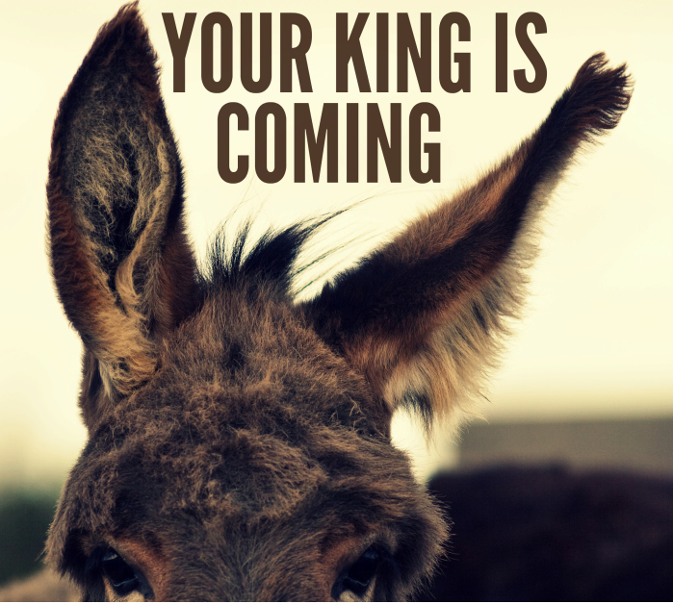
Jesus’ entry into Jerusalem marks the beginning of the Passion Week

Slide 4
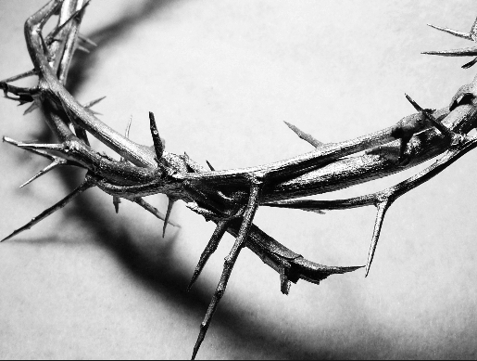
Passion in Latin word is “Passio” which means to endure suffering

Slide 5
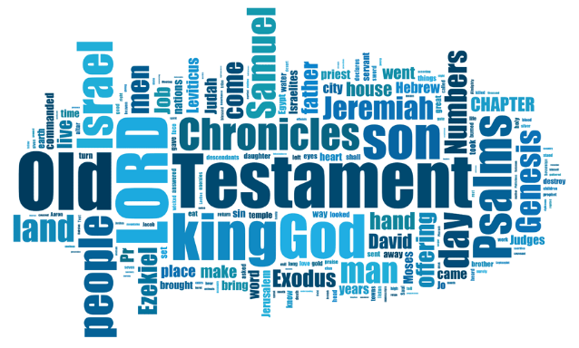
The Passion Week
Notes:
Good Friday and Easter are celebrated widely, 4 gospels, 8/21 in John gospel focus on this one week, foretold in the old testament in many places

Slide 6

The passion(suffering) of the Christ that had brought us PEACE with God.
Notes:
A significant life changing event

Slide 7

Topic:
Making preparations to face death
Notes:
Jesus was going to die –
what would you do if you know you are going to die ?

Slide 8

Death is the destiny of everyone
Ecclesiastes 7:2

Slide 9
A wise man thinks a lot about death, while a fool only thinks about having a good time - NLT
The heart of the wise is in the house of mourning, but the heart of the fools is in the house of pleasure – NIV
Ecclesiastes 7:4
Notes:
We ought to think about our death – thinking helps us or prepares us to face death

Slide 10
Jesus made preparations for his death
While Jesus was in Bethany in the home of Simon the Leper, ⁷ a woman came to him with an alabaster jar of very expensive perfume, which she poured on his head as he was reclining at the table
When she poured this perfume on my body, she did it to prepare me for burial.
Matthew 26:6-7,12

Slide 11
The most IMPORTANT preparation of all..

Slide 12
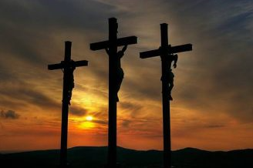
Jesus and the penitent thief

Slide 13
Many fear death because they are uncertain about where they would go after they die

Slide 14
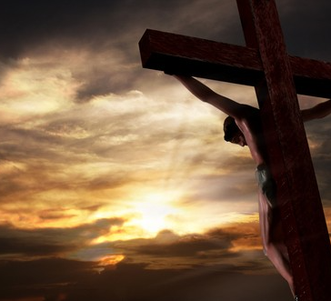
'Father, into your hands I commit my spirit.' When he had said this, he breathed his last." (Luke 23:46).

Slide 15
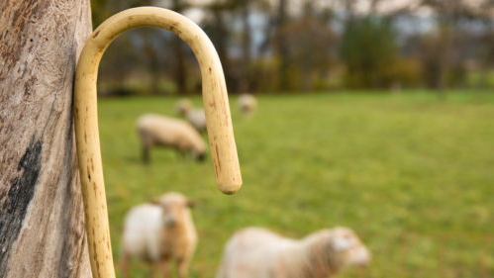
Death is still a fearsome thing to face but we have no other person better than Jesus to lead us through.

Slide 16
ALL THE WAY MY SAVIOUR LEADS ME
All the way my Saviour leads me
What have I to ask beside?
Can I doubt His faithful mercies?
Who through life has been my guide
Heavenly peace, divinest comfort
Here by faith in Him to dwell
For I know whate'er fall me
Jesus doeth all things well
All the way my Saviour leads me
Cheers each winding path I tread,
Gives me grace for every trial,
Feeds me with the living bread.
Though my weary steps may falter,
And my soul athirst may be,
Gushing from the Rock before me,
Lo! a spring of joy I see

Slide 17
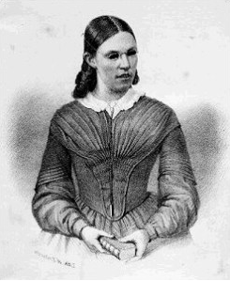
Frances Jane Crosby aka
Fanny Crosby
1820 - 1915

Slide 18

Making another preparation
Discover your calling and do what God had called you to do.

Slide 19
“What we have is God’s gift to us but what we are is our gift to God.”

Slide 20
Saved By Grace
Words by Fanny Crosby
Someday the silver cord will break,
And I no more as now shall sing;
But, oh, the joy when I shall wake
Within the palace of the King!
Refrain:
And I shall see Him face to face,
And tell the story—Saved by grace.
Someday, when fades the golden sun
Beneath the rosy tinted west,
My blessed Lord will say, “Well done!”
And I shall enter into rest.

Slide 21
What others say about Fanny Crosby

Slide 22
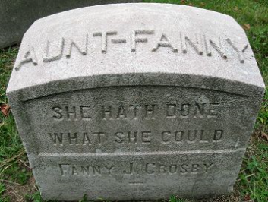
SHE HATH DONE WHAT SHE COULD

Slide 23

Fanny Crosby’s songs live on even after she died for more than 100 years…
Leave a lasting legacy!!

Slide 24
Make your preparations today !!
Physical preparation
Spiritual preparation
Discover your calling (if you have not) and serve God

