Slide 1
You Lack

Slide 2
¹³ People were bringing little children to Jesus for him to place his hands on them, but the disciples rebuked them. ¹⁴ When Jesus saw this, he was indignant. He said to them, ‘Let the little children come to me, and do not hinder them, for the kingdom of God belongs to such as these. ¹⁵ I tell you the truth, anyone who will not receive the kingdom of God like a little child will never enter it.’ ¹⁶ And he took the children in his arms, put his hands on them and blessed them.
¹⁷ As Jesus started on his way, a man ran up to him and fell on his knees before him. ‘Good teacher,’ he asked, ‘what must I do to inherit eternal life?’
¹⁸ ‘Why do you call me good?’ Jesus answered. ‘No one is good – except God alone. ¹⁹ You know the commandments: “You shall not murder, you shall not commit adultery, you shall not steal, you shall not give false testimony, do not defraud, honour your father and mother.”’
²⁰ ‘Teacher,’ he declared, ‘all these I have kept since I was a boy.’
²¹ Jesus looked at him and loved him. ‘One thing you lack,’ he said. ‘Go, sell everything you have and give to the poor, and you will have treasure in heaven. Then come, follow me.’

Slide 3
²² At this the man’s face fell. He went away sad, because he had great wealth.
²³ Jesus looked round and said to his disciples, ‘How hard it is for the rich to enter the kingdom of God!’
²⁴ The disciples were amazed at his words. But Jesus said again, ‘Children, how hard it is to enter the kingdom of God! ²⁵ It is easier for a camel to go through the eye of a needle than for a rich man to enter the kingdom of God.’
²⁶ The disciples were even more amazed, and said to each other, ‘Who then can be saved?’
²⁷ Jesus looked at them and said, ‘With man this is impossible, but not with God; all things are possible with God.’
²⁸ Then Peter spoke up, ‘We have left everything to follow you!’
²⁹ ‘I tell you the truth,’ Jesus replied, ‘no one who has left home or brothers or sisters or mother or father or children or fields for me and the gospel ³⁰ will fail to receive a hundred times as much in this present age: homes, brothers, sisters, mothers, children and fields – and with them persecutions – and in the age to come eternal life.³¹ But many who are first will be last, and the last first.’
(Mark 10)

Slide 4
What Must I Do?
¹⁷ As Jesus started on his way, a man ran up to him and fell on his knees before him. ‘Good teacher,’ he asked, ‘what must I do to inherit eternal life?’
(Mark 10)

Slide 5
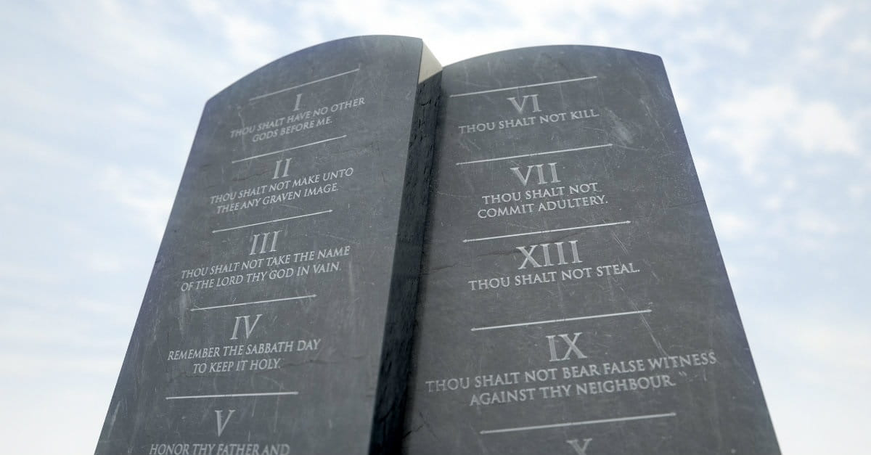
You Know The Commandments
¹⁸ ‘Why do you call me good?’ Jesus answered. ‘No one is good – except God alone. ¹⁹ You know the commandments: “You shall not murder, you shall not commit adultery, you shall not steal, you shall not give false testimony, do not defraud, honour your father and mother.”’ . (Mark 10)

Slide 6
The purpose of the law was to expose men as sinners, unworthy of God’s blessings, and only worthy of His wrath. Before this man can really act on the goodness of the Lord Jesus, he must first come to the painful realization of his own sin. No man needs the goodness of God if he has goodness of his own. Jesus thus pressed the man to consider his righteousness in the light of the law, since this was the basis of his righteousness, in his own mind. He was thinking in terms of his works, and thus he was thinking in terms of law, not grace. Jesus was graciously and gently trying to show him that this way of approach was not possible.
(Bob Deffinbaugh, "Blessed Babes And A Miserable Millionaire”)

Slide 7
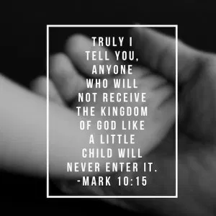
… the children who come to Jesus are very young children. Luke tells us, in fact, that they are babies. Babies do not trust nor do they practice humility. Babies are carried to Jesus. They make no conscious decisions. They speak no words. They understand no words. The rich young ruler speaks of his “works” from the point of his childhood. It is just as though Luke has put these two paragraphs side-by-side in order to show us something very important by contrast. The rich young ruler wishes to talk about what he has done, since childhood, in order to earn God’s favour.

Slide 8
Jesus takes children in his arms, and tells everyone that they must enter the kingdom of God the way these children have come to him … The thing which commends children to Christ is their helplessness, not their goodness. And this is precisely what must characterize every person who comes into the kingdom – they come as those who are helpless and undeserving, entering into God’s blessings because of His goodness and grace, not due to their own merits. Here is the child-like quality, which must characterize all who would enter into His kingdom.
(Bob Deffinbaugh, “Blessed Babes And A Miserable Millionaire”)

Slide 10
A Proud Claim
²⁰ ‘Teacher,’ he declared, ‘all these I have kept since I was a boy.’ (Mark 10)

Slide 11
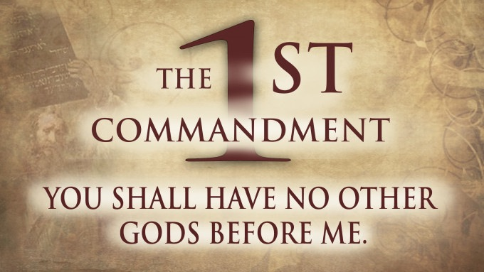

Slide 12
²¹ Jesus looked at him and loved him. ‘One thing you lack,’ he said. ‘Go, sell everything you have and give to the poor, and you will have treasure in heaven. Then come, follow me.’ (Mark 10)
²¹ Jesus answered, ‘If you want to be perfect, go, sell your possessions and give to the poor, and you will have treasure in heaven. Then come, follow me.’ (Matthew 19)

Slide 13
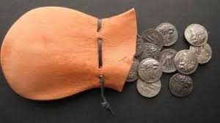
²² At this the man’s face fell. He went away sad, because he had great wealth.
(Mark 10)
Jesus spoke of “treasure in heaven” because the man’s great problem was that of his treasure, a wrongly valued treasure, an earthly treasure – his possessions, his wealth. Jesus speaks of “treasure in heaven” because it is that of ultimate, infinite, value. He speaks of it because it is unlike earthly treasure. Money was this man’s idol, that which he loved more than God, and thus he could never love the Lord God with all of his heart, mind, soul, and strength. God was a means, not an end, and money was this man’s end, his prize, his goal, his ultimate good.
(Bob Deffinbaugh, "Blessed Babes And A Miserable Millionaire”)

Slide 14
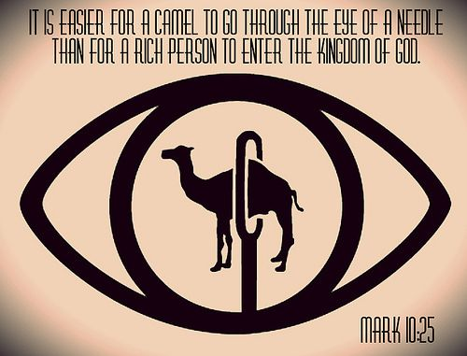
Riches – A Hindrance?

Slide 15
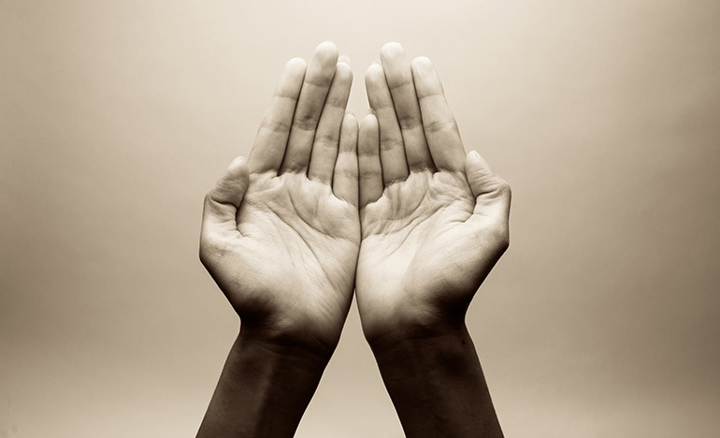
“Your attachment to your possessions needs to be replaced by an attachment to me. Stop treasuring money and start treasuring me. You want to inherit eternal life. You want to enter the kingdom of heaven. You want to be justified. Only by your attachment to me will you inherit eternal life, enter the kingdom, be justified.”
(John Piper, “Did Jesus Preach The Gospel of Evangelicalism?”)

Slide 16
²⁴ No one can serve two masters. Either he will hate the one and love the other, or he will be devoted to the one and despise the other. You cannot serve both God and Money. (Matthew 6)

Slide 17
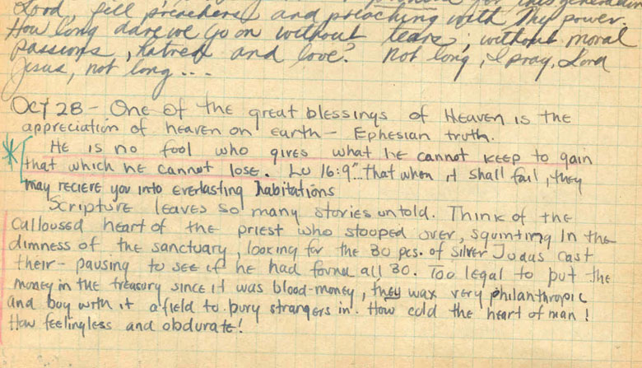

Slide 19
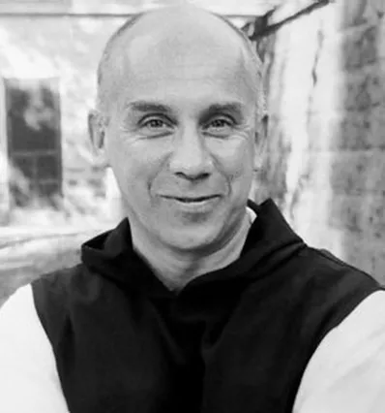
Happiness consists in finding out precisely what the one thing necessary may be, in our lives, and in gladly relinquishing all the rest. For then, by divine paradox, we find that everything else is given us together with the one thing we needed.
(Thomas Merton, "No Man Is An Island”)

Slide 20
One Thing

Slide 22
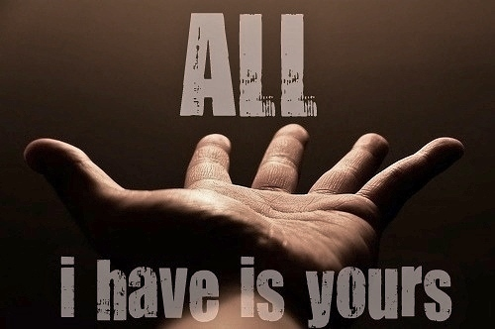

Slide 23
You may be congratulating yourself on the sacrifices you have made for God. As I understand this text, and as I think through the Scriptures, there is a sense in which we are called to a life of self-denial and sacrifice. But there is also a sense in which we make no sacrifices at all. The man who found and purchased the “pearl of great price” did not think of the price he paid as a sacrifice at all. It was a bargain. What good is it, Jesus said, if a man gained the whole world, to lose his own soul? What loss is it, to give up riches, power, and even life itself, if we gain God’s gift of eternal life, and experience the joy of our salvation? How can we speak of sacrifice when giving up things in this life results in a 100 fold blessing now, and an eternal blessing as well? We should think much more in terms of our Lord’s sacrifice, and much less in terms of our own. And yet, even He rejoiced in the blessedness of giving Himself up for the salvation of lost sinners. What a Saviour!
(Bob Deffinbaugh, "Blessed Babes And A Miserable Millionaire”)

Slide 24
What Is Yours?

