Slide 1
Keep On Praying
Ephesians 6:18

Slide 2
Ephesians 6:18
¹⁸ praying always with all prayer and supplication in the Spirit, being watchful to this end with all perseverance and supplication for all the saints—

Slide 3
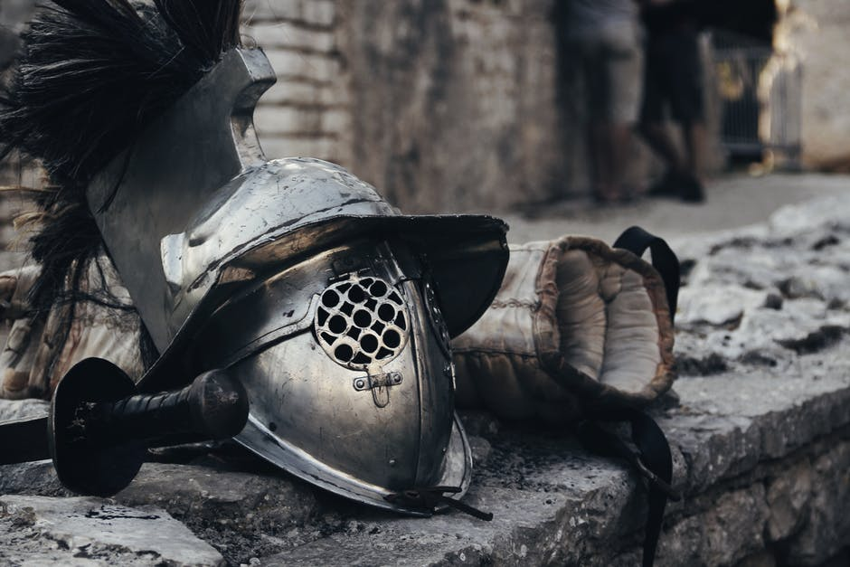

Slide 4
Ephesians 6:18
4 aspects of prayer
1. Frequency of prayer
2. Forms of prayer
3. “Force” of prayer
4. Focus of prayer

Slide 5
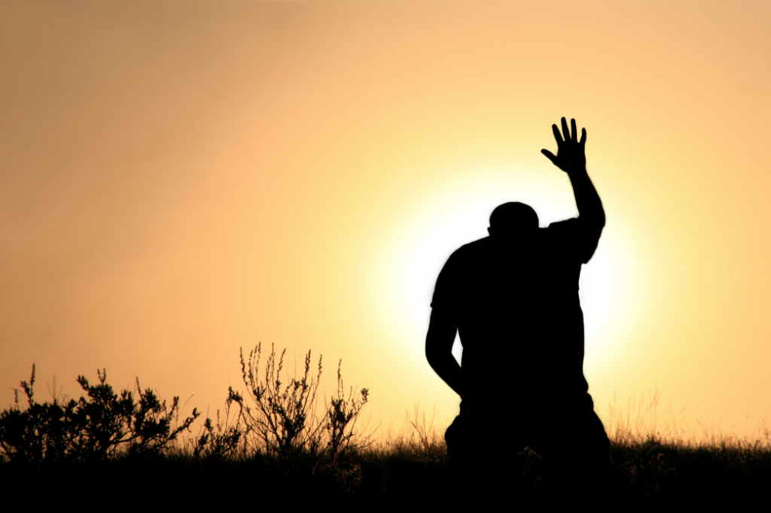
Frequency of prayer:
Pray always

Slide 6
Luke 18:1-8
Then He spoke a parable to them, that men always ought to pray and not lose heart, ² saying: “There was in a certain city a judge who did not fear God nor ^{[a]}regard man. ³ Now there was a widow in that city; and she came to him, saying, ^{[b]}‘Get justice for me from my adversary.’⁴ And he would not for a while; but afterward he said within himself, ‘Though I do not fear God nor regard man, ⁵ yet because this widow troubles me I will ^{[c]}avenge her, lest by her continual coming she weary me.’ ”

Slide 7
Luke 18:1-8
⁶ Then the Lord said, “Hear what the unjust judge said. ⁷ And shall God not avenge His own elect who cry out day and night to Him, though He bears long with them? ⁸ I tell you that He will avenge them speedily. Nevertheless, when the Son of Man comes, will He really find faith on the earth?”

Slide 8
Daniel 10:12-14
¹² Then he (the angel) said to me, “Do not fear, Daniel, for from the first day that you set your heart to understand, and to humble yourself before your God, your words were heard; and I have come because of your words. ¹³ But the prince of the kingdom of Persia withstood me twenty-one days; and behold, Michael, one of the chief princes, came to help me, for I had been left alone there with the kings of Persia. ¹⁴ Now I have come to make you understand what will happen to your people in the latter days, for the vision refers to many days yet to come.”

Slide 9
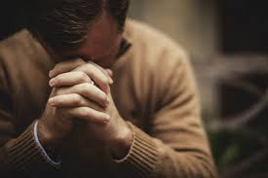
Brother Lawrence
and The Practice of the
Presence of God

Slide 10
The Practice of the Presence of God
“We should establish ourselves in a sense of God’s Presence by continually conversing with Him. It was a shameful thing to quit His conversation to think of trifles and fooleries.”

Slide 11
The Practice of the Presence of God
“time of business,” ........“does not with me differ from the time of prayer. In the noise and clatter of my kitchen, while several persons are at the same time calling for different things, I possess God in as great tranquillity is if I were upon my knees at the Blessed Supper.”

Slide 12
Forms of prayer:
....with all prayer and supplication

Slide 13
“Force” in prayer:
...... in the Spirit

Slide 14
Matthew Henry
“The Spirit in the heart never contradicts the Spirit in the word. Those desires that are contrary to the will of God do not come from the Spirit. The Spirit interceding in us evermore melts our wills into the will of God.”

Slide 15
Romans 8:26-27
²⁶ Likewise the Spirit also helps in our weaknesses. For we do not know what we should pray for as we ought, but the Spirit Himself makes intercession ^{[g]}for us with groanings which cannot be uttered. ²⁷ Now He who searches the hearts knows what the mind of the Spirit is, because He makes intercession for the saints according to the will of God.

Slide 16
Barry Chant (Breaking the Power of the Past)
“the Greek adjective used here (alaletos) does not mean totally inexpressible. There is another word for that (alalos – unable to speak, dumb). What it means is ‘unable to be expressed in rational speech’. So the Holy Spirit enables us to intercede in ways which transcends normal linguistic forms. (the phrase occurs in secular Greek, for example, to describe shared secrets of love.)”

Slide 17
Eerdmans Murray: The Epistles to the Romans 1973
“The groaning will have to be understood as the groaning which are registered in the hearts of the children of God. We cannot reasonably think of the Holy Spirit himself, apart from the agency and instrumentality of those on whose behalf he intercedes, as presenting his intercessions to the Father in the form of his own groanings. The reference to the hearts in verse 27 clearly implies that the hearts are those of the children of God. It must be, therefore, in their hearts that the groaning take place and groanings are those of the saints. They are, however, the media of the Holy Spirit’s intercessions and they ascend to the throne of grace in the form of groanings.”

Slide 18
John Calvin
“Not that he [the Spirit] actually prays or groans but arouses in us assurance, desires, and sighs, to conceive which our natural powers could scarcely suffice. And Paul, with good reason, calls ‘unspeakable’ these groans which believers give forth under the guidance of the Spirit.”

Slide 19
1 Corinthians 14:13-15
¹³ Therefore let him who speaks in a tongue pray that he may interpret. ¹⁴ For if I pray in a tongue, my spirit prays, but my understanding is unfruitful. ¹⁵ What is the conclusion then? I will pray with the spirit, and I will also pray with the understanding. I will sing with the spirit, and I will also sing with the understanding.

Slide 20
1 Corinthians 14:4
⁴ He who speaks in a tongue edifies himself,
Jude 20
²⁰ But you, beloved, building yourselves up on your most holy faith, praying in the Holy Spirit,......

Slide 21
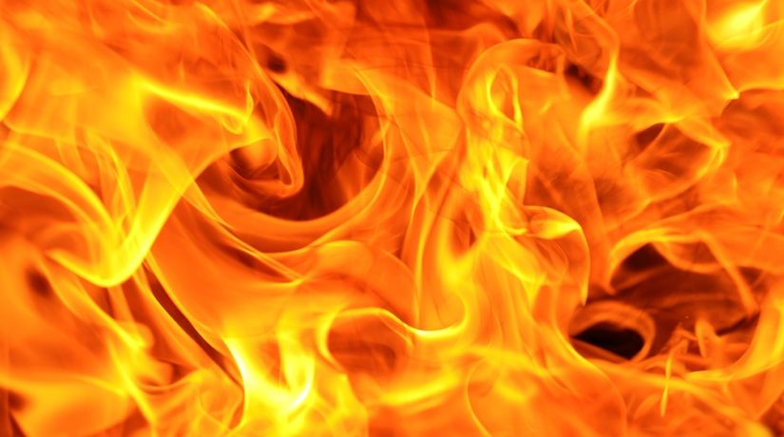
Jackie Pullinger
and Chasing the Dragon

Slide 22
4. Focus in prayer:
...being watchful to this end with all perseverance and supplication for all the saints—

Slide 23
1 Peter 5:8
Be sober, be vigilant; because your adversary the devil walks about like a roaring lion, seeking whom he may devour.

Slide 24
2 Corinthians 2:11
¹¹ lest Satan should take advantage of us; for we are not ignorant of his devices.

Slide 25
Finale: Prayer & Evangelism Ephesians 6:19-20
¹⁹ and for me, that utterance may be given to me, that I may open my mouth boldly to make known the mystery of the gospel, ²⁰ for which I am an ambassador in chains; that in it I may speak boldly, as I ought to speak.

Slide 26
Moravian Revival
100 years of prayer
300 missionaries

