Slide 1

FPBC
Vision Sunday
Where are we heading?
13/1/2019

Slide 2



We live in a changing world
Change (external and internal) brings challenges to the church

Slide 3
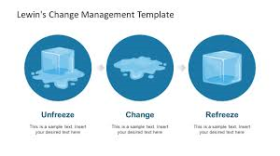
Stay relevant
Lewin’s Change Management Theory
What worked yesterday and today may not work tomorrow!!
Unfreeze
Change
Refreeze
Think ahead

Slide 4

Scriptural Roots of Ministry (SRM)
THE CHANGE PROCESS
The SRM Study
6 Sections
3 Years
“Bottom up” approach
> 20 Leaders provided IF/THEN Statements
> 400 IF/THEN statements created
Discovered 6 keys for building FPBC’s Future

Slide 5
The SRM Process
3 years
SRM Kick-off
Jan 2016
Forum for the Future
Section 1-3
Aug 2017
Final Forum
Section 4-6
Oct 2018
SRM Finale
Nov 2018

Slide 6


Challenges & threats facing Malaysian Churches
SRM
Aug 2017
State of the church in Malaysia
Politics
Education
Families
Youths
Islamization
Social Media
7

Slide 7
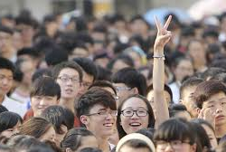
#1 Challenge
From the forum for the future
Discipling Millennials

Slide 8
6 key essentials for building FPBC’s Future
SRM OUTCOME:
Spirit-led &
Spirit-empowered Church
Making Disciples
Build strong Relationships
Experiencing God
Prayer
Equipping Believers with the WORD

Slide 9
Cell Group
Be a member of a Cell Group TODAY
BELIEVE
BLESS
BELONG
CG’s Core Values
is FPBC’s
Transformational
Key vehicle
Believe
Belong
Bless
City on a Hill
for building relationships, maturing in Christ and making disciples
Relational
Missional

Slide 10

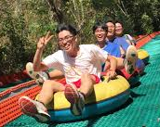





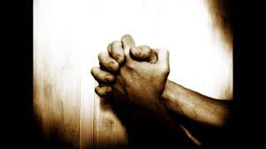
WORD
Building Firm Foundations through the WORD
Building Relationships
Once a month
Sat
4-6pm
Increase CG participation
Weekly Prayer
Sun 9-10am
YA - Youth Service

