Slide 1
Belong
Chosen to belong

Slide 2
Our Vision
fpbcpg.org
To be a “City On A Hill” (Matthew 5:14)
Our calling thus is to be a people that will let our light shine before men in the community where we are located and even beyond in order that they might give praise to our Father in heaven

Slide 3
Our Core Values
fpbc.org
Belong - relational
Believe - transformational
Bless - missional

Slide 4
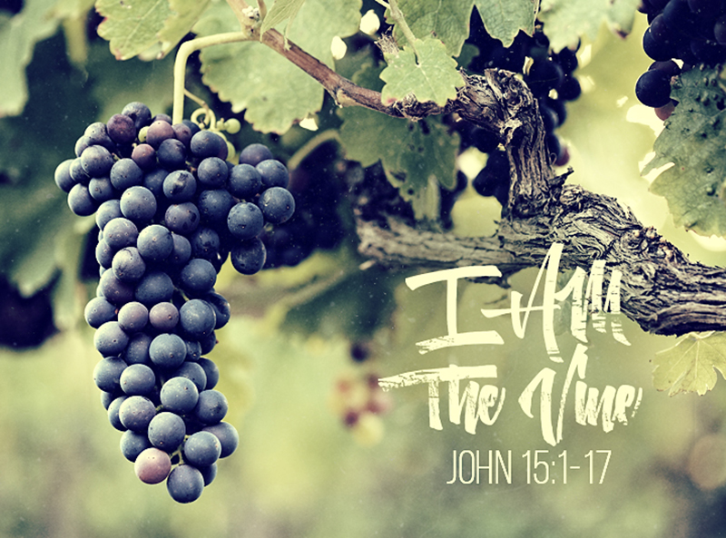

Slide 5
The Vine and the Branches
John 15:1-17
I am the true vine, and my Father is the gardener. He cuts off every branch in me that bears no fruit, while every branch that does bear fruit he prunes so that it will be even more fruitful. You are already clean because of the word I have spoken to you. Remain in me, as I also remain in you. No branch can bear fruit by itself; it must remain in the vine. Neither can you bear fruit unless you remain in me. I am the vine; you are the branches.

Slide 6
The Vine and the Branches
John 15:1-17
If you remain in me and I in you, you will bear much fruit; apart from me you can do nothing. If you do not remain in me, you are like a branch that is thrown away and withers; such branches are picked up, thrown into the fire and burned. If you remain in me and my words remain in you, ask whatever you wish, and it will be done for you. This is to my Father’s glory, that you bear much fruit, showing yourselves to be my disciples.

Slide 7
The Vine and the Branches
John 15:1-17
As the Father has loved me, so have I loved you. Now remain in my love. If you keep my commands, you will remain in my love, just as I have kept my Father’s commands and remain in his love. I have told you this so that my joy may be in you and that your joy may be complete. My command is this: Love each other as I have loved you. Greater love has no one than this: to lay down one’s life for one’s friends.

Slide 8
The Vine and the Branches
John 15:1-17
You are my friends if you do what I command. I no longer call you servants, because a servant does not know his master’s business. Instead I have called you friends, for everything that I learned from my Father I have made known to you. You did not choose me, but I chose you and appointed you so that you might go and bear fruit - fruit that will last - and so that whatever you ask in my name the Father will give you. This is my command: love each other.

Slide 9
Jesus chose us to belong to Him
Jesus called us to remain in Him and bear fruit
The way to remain in Jesus’ love is to obey His command
Jesus’ command is for us to love each other

Slide 10

Ephesians 4:1-16

Slide 11
Body of Christ
Ephesians 4:1-16
As a prisoner for the Lord, then, I urge you to live a life worthy of the calling you have received. Be completely humble and gentle; be patient, bearing with one another in love. Make every effort to keep the unity of the Spirit through the bond of peace. There is one body and one Spirit, just as you were called to one hope when you were called; one Lord, one faith, one baptism; one God and Father of all, who is over all and through all and in all.

Slide 12
Body of Christ
Ephesians 4:1-16
But to each one of us grace has been given as Christ apportioned it. This is why it says: “When he ascended on high, he took many captives and gave gifts to his people.” (What does “he ascended” mean except the he also descended to the lower earthly regions? He who descended is the very one who ascended higher than all the heavens, in order to fill the whole universe.). So Christ himself gave the apostles, the prophets, the evangelists, the pastors and teachers,

Slide 13
Body of Christ
Ephesians 4:1-16
to equip his people for works of service, so that the body of Christ may be built up until we all reach unity in the faith and in the knowledge of the Son of God and become mature, attaining to the whole measure of the fullness of Christ. Then we will no longer be infants, tossed back and forth by the waves, and blown here and there by every wind of teaching and by the cunning and craftiness of people in their deceitful scheming.

Slide 14
Body of Christ
Ephesians 4:1-16
Instead, speaking the truth in love, we will grow to become in every respect the mature body of him who is the head, that is, Christ. From him the whole body, joined and held together by every supporting ligament, grows and builds itself up in love, as each part does its work.

Slide 15
Oneness
Jesus gives us different gifts
Jesus call us to perform different functions
We are equipped to do work of service to build up the church
Help each other to mature and be like Christ

