Slide 1

Preaching Series

Slide 2


Focus For 2019

Slide 3


Slide 4
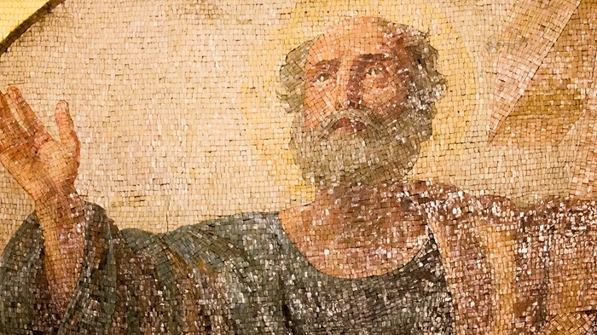
Background

Slide 5
The Corinthian Church
⁴ I always thank my God for you because of his grace given you in Christ Jesus. ⁵ For in him you have been enriched in every way – with all kinds of speech and with all knowledge – ⁶ God thus confirming our testimony about Christ among you. ⁷ Therefore you do not lack any spiritual gift as you eagerly wait for our Lord Jesus Christ to be revealed. (1 Corinthians 1)

Slide 6
⁹ God is faithful, who has called you into fellowship with his Son, Jesus Christ our Lord. (1 Corinthians 1)
They had not understood the implications of their calling, and the relationship they personally and individually had with Jesus Christ himself. Instead, as we see, beginning with the very next verse, the apostle has to deal with divisions, scandals, lawsuits, immorality, drunkenness, quarreling, and with much misunderstanding of the truth about idols and demons and various other things. It is very clear, as you read this, that, despite this fullness of provision which they had received, they were experiencing a great failure in the church. They had all this ability to do all these mighty things in the Spirit, but not much was happening out in the city. Instead of making an impact on Corinth, Corinth was making an impact on the church. All these ugly attitudes and actions and activities that were going on every day and night out in the city were beginning to infiltrate into the church, and instead of the church changing the city, the city was changing the church. That was the problem. Despite all this mighty provision, there was no manifestation of the power of God. (Ray Stedman, “The Corinthian Crisis”)

Slide 7

Three Major Problems
Divisions
Disorder
Difficulties

Slide 8
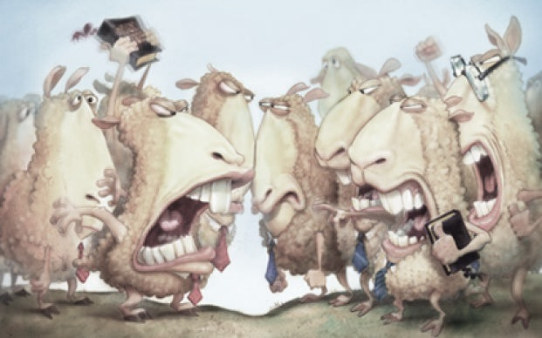
Divisions In The Church
¹¹ My brothers and sisters, some from Chloe’s household have informed me that there are quarrels among you. ¹² What I mean is this: one of you says, ‘I follow Paul’; another, ‘I follow Apollos’; another, ‘I follow Cephas’; still another, ‘I follow Christ.’
(1 Corinthians 1)

Slide 9
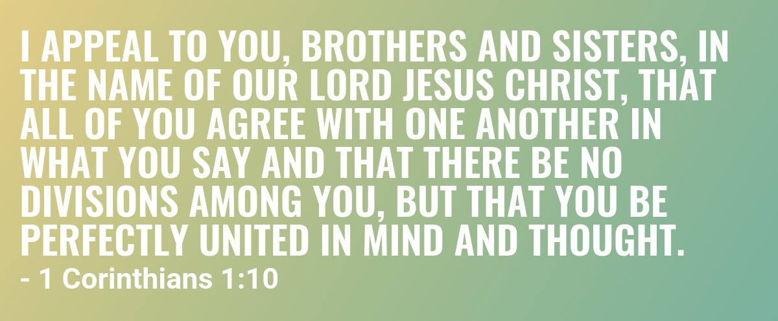
Paul’s Appeal

Slide 10

Paul’s Appeal
There is no other name big enough, great enough, glorious enough, and powerful enough to gather everybody together, despite the diversity of viewpoint and the differences of background or status in life, than the name of Jesus. That is why the apostle appeals to it. He recognizes that we share a common life if we have come to Christ; we are brothers and sisters because we have his life in us. He is the ground, always, of unity. And more than that, we have a responsibility to obey him, to follow his Lordship. Therefore, the only basis upon which you can get Christians to agree is by setting before them the Person of the Lord Jesus, and calling them back to that fundamental base. This is what Paul does here.
(Ray Stedman, “Behind Divisions”)

Slide 11
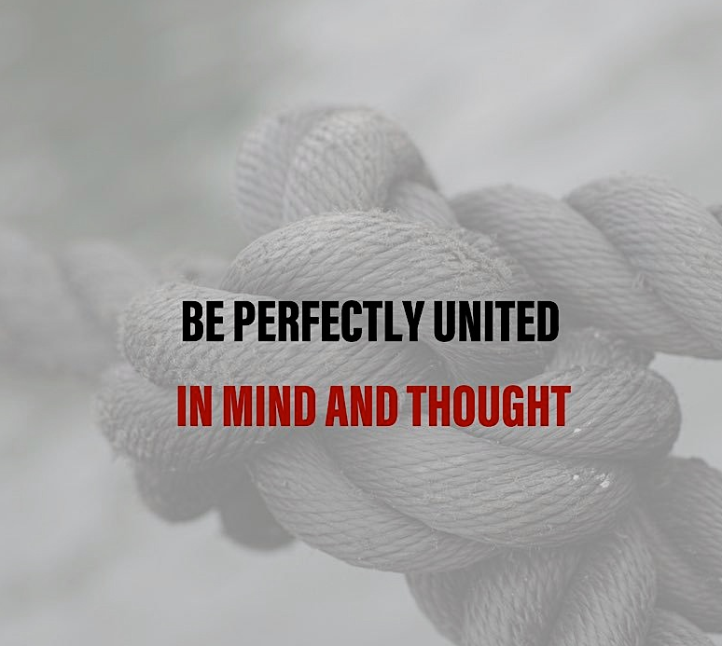
Paul’s Appeal
¹⁰ I appeal to you, brothers and sisters, in the name of our Lord Jesus Christ, that all of you agree with one another in what you say and that there be no divisions among you, but that you be …
(1 Corinthians 1)

Slide 12
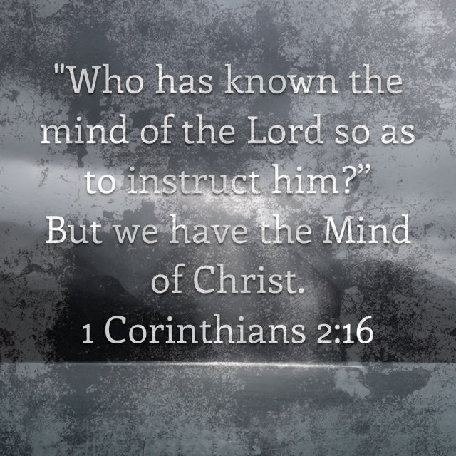

Slide 13
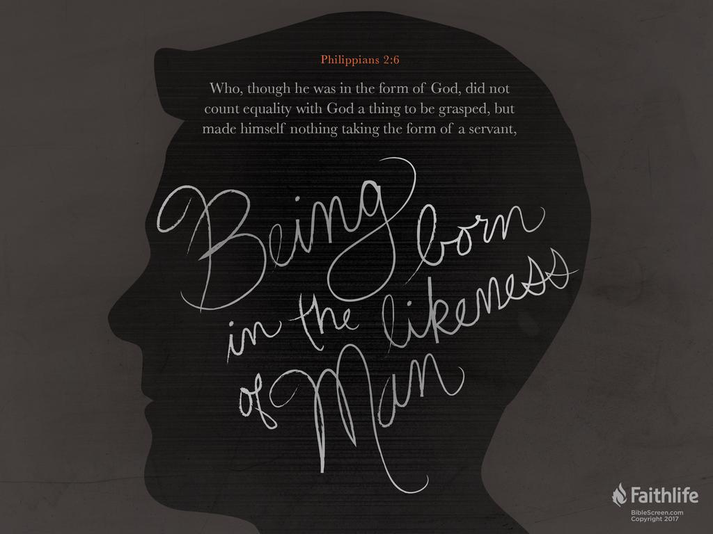
The Mind of Christ
⁵ Let this mind be in you which was also in Christ Jesus …
(Philippians 2)
When everybody decides to put the things of Christ first, and is willing to suffer loss that the honor and glory of Christ might be advanced, that is what brings harmony in a congregation. That is always the unifying factor in a church, and that is the mind that is to be among us, the mind that does not consider itself the most important thing.
(Ray Stedman, “Behind Divisions”)

Slide 14

Paul’s Question
¹³ Is Christ divided? Was Paul crucified for you? Were you baptised in the name of Paul? (1 Corinthians 1)

Slide 15

The Church And Its Leaders
⁵ What, after all, is Apollos? And what is Paul? Only servants, through whom you came to believe – as the Lord has assigned to each his task. ⁶ I planted the seed, Apollos watered it, but God has been making it grow. ⁷ So neither the one who plants nor the one who waters is anything, but only God, who makes things grow. (1 Corinthians 3)
¹ This, then, is how you ought to regard us: as servants of Christ and as those entrusted with the mysteries God has revealed. (1 Corinthians 4)

Slide 16
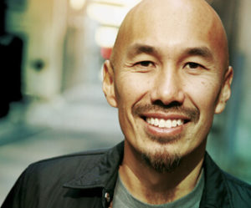
Am I part of the problem?
That’s the question Francis Chan asked himself as he surveyed his thriving megachurch. Cornerstone Church in California had grown from 30 to 6,000 congregants in the 15 years since Chan planted it. Yet he wasn’t satisfied.
He was leading a typical Western, evangelical church, and that, according to Chan, was exactly the problem. Everything centred around “a speaking gift and a sermon”, he says. In other words, people were flocking to preacher-man Chan, rather than seeking an encounter with God. When this magazine last interviewed him, in 2010, he put it this way: “One of the problems at our church is when I hear the words ‘Francis Chan’ more than I hear the words ‘Holy Spirit’.”

Slide 17

Paul’s Rebuke
¹ Brothers and sisters, I could not address you as people who live by the Spirit but as people who are still worldly – mere infants in Christ. ² I gave you milk, not solid food, for you were not yet ready for it. Indeed, you are still not ready.
³ You are still worldly. For since there is jealousy and quarrelling among you, are you not worldly? Are you not acting like mere humans? ⁴ For when one says, ‘I follow Paul,’ and another, ‘I follow Apollos,’ are you not mere human beings? (1 Corinthians 3)

Slide 18

Disorders In The Church
¹¹ But now I am writing to you that you must not associate with anyone who claims to be a brother or sister but is sexually immoral or greedy, an idolater or slanderer, a drunkard or swindler. Do not even eat with such people. (1 Corinthians 5)

Slide 19
¹ It is actually reported that there is sexual immorality among you, and of a kind that even pagans do not tolerate: a man is sleeping with his father’s wife. ² And you are proud! Shouldn’t you rather have gone into mourning and have put out of your fellowship the man who has been doing this? (1 Corinthians 5)

Slide 20

I Live For Jesus Now
"Drunks, homosexuals, adulterers, liars, fornicators, thieves, atheists and idolators - Hell awaits you."

Slide 21

The post remains online and on Sunday the player said he was standing by "what the Bible says”.
Following a service at the Truth Of Jesus Christ Church, he told the Sydney Morning Herald newspaper: "I share it with love. I can see the other side of the coin where people's reactions are the total opposite to how I'm sharing it.
"First and foremost, I live for God now. Whatever He wants me to do, I believe His plans for me are better than whatever I can think. If that's not to continue on playing, so be it," he added.
"In saying that, obviously I love playing footy and if it goes down that path I'll definitely miss it. But my faith in Jesus Christ is what comes first."

Slide 22

The Believer’s Freedom

Slide 23

¹³ You say, ‘Food for the stomach and the stomach for food, and God will destroy them both.’ The body, however, is not meant for sexual immorality but for the Lord, and the Lord for the body. ¹⁴ By his power God raised the Lord from the dead, and he will raise us also. ¹⁵ Do you not know that your bodies are members of Christ himself? Shall I then take the members of Christ and unite them with a prostitute? Never! ¹⁶ Do you not know that he who unites himself with a prostitute is one with her in body? For it is said, ‘The two will become one flesh.’

Slide 24
¹⁷ But whoever is united with the Lord is one with him in spirit. ¹⁸ Flee from sexual immorality. All other sins a person commits are outside the body, but whoever sins sexually, sins against their own body. ¹⁹ Do you not know that your bodies are temples of the Holy Spirit, who is in you, whom you have received from God? You are not your own; ²⁰ you were bought at a price. Therefore honour God with your bodies. (1 Corinthians 6)

Slide 25

⁷ Get rid of the old yeast, so that you may be a new unleavened batch – as you really are. For Christ, our Passover lamb, has been sacrificed. (1 Corinthians 5)

Slide 26
Summary

Slide 27
Summary
Immature
Unspiritual

Slide 28
End of Part One

