Slide 1
A True Church Leader
1 Corinthians
4 : 1-17
21st July 2019

Slide 2
This, then, is how you ought to regard us: as servants of Christ and as those entrusted with the mysteries God has revealed. ² Now it is required that those who have been given a trust must prove faithful. ³ I care very little if I am judged by you or by any human court; indeed, I do not even judge myself. ⁴ My conscience is clear, but that does not make me innocent. It is the Lord who judges me. ⁵ Therefore judge nothing before the appointed time; wait until the Lord comes. He will bring to light what is hidden in darkness and will expose the motives of the heart. At that time each will receive their praise from God.

Slide 3
⁶ Now, brothers and sisters, I have applied these things to myself and Apollos for your benefit, so that you may learn from us the meaning of the saying, “Do not go beyond what is written.” Then you will not be puffed up in being a follower of one of us over against the other. ⁷ For who makes you different from anyone else? What do you have that you did not receive? And if you did receive it, why do you boast as though you did not? ⁸ Already you have all you want! Already you have become rich! You have begun to reign—and that without us! How I wish that you really had begun to reign so that we also might reign with you!

Slide 4
⁹ For it seems to me that God has put us apostles on display at the end of the procession, like those condemned to die in the arena. We have been made a spectacle to the whole universe, to angels as well as to human beings. ¹⁰ We are fools for Christ, but you are so wise in Christ! We are weak, but you are strong! You are honored, we are dishonored! ¹¹ To this very hour we go hungry and thirsty, we are in rags, we are brutally treated, we are homeless. ¹² We work hard with our own hands. When we are cursed, we bless; when we are persecuted, we endure it; ¹³ when we are slandered, we answer kindly. We have become the scum of the earth, the garbage of the world—right up to this moment.

Slide 5
¹⁴ I am writing this not to shame you but to warn you as my dear children. ¹⁵ Even if you had ten thousand guardians in Christ, you do not have many fathers, for in Christ Jesus I became your father through the gospel. ¹⁶ Therefore I urge you to imitate me. ¹⁷ For this reason I have sent to you Timothy, my son whom I love, who is faithful in the Lord. He will remind you of my way of life in Christ Jesus, which agrees with what I teach everywhere in every church.

Slide 6
Background & Context
1 Cor 3:18-22

Slide 7
¹⁸ Do not deceive yourselves. If any of you think you are wise by the standards of this age, you should become “fools” so that you may become wise. ¹⁹ For the wisdom of this world is foolishness in God’s sight. As it is written: “He catches the wise in their craftiness”; ²⁰ and again, “The Lord knows that the thoughts of the wise are futile.”^{[21} So then, no more boasting about human leaders! All things are yours, ²² whether Paul or Apollos or Cephas or the world or life or death or the present or the future—all are yours, ²³ and you are of Christ, and Christ is of God.

Slide 8
No more boasting of human leaders !
Paul, Apollos, Cephas are great leaders, but there is no need to boast about them.

Slide 9
An innate desire to want to be associated with the “who’s who”
Association with great leaders gives recognition, it raises profile, gives a sense of security albeit a false one

Slide 10
Where does that desire come from ?
It comes from a false belief system that we lack.
We do not have enough or we do not measure up.

Slide 11
All things are yours !!
We have no lack. We belong to God

Slide 12
This is how you regard your Leaders
Servants
Stewards

Slide 13
Marks of a True Leader – F A T
Faithful
Accountable
Tested

Slide 14
Faithful
Stay the course despite the most difficult circumstances

Slide 15
Accountable
Fear God because there is a need to give an account to HIM

Slide 16
Tested
Have proven themselves

Slide 17
Leaders live by and are measured by these principles
Paul, Apollos and Cephas lived by these principles

Slide 18
These principles are boundaries
To keep us from being “puffed up” and cause division

Slide 19
The Condition of the Church
“Have all you want”
Rich
Reigning
“At the front end of the procession”
“Wise”
Honoured
Strong

Slide 20
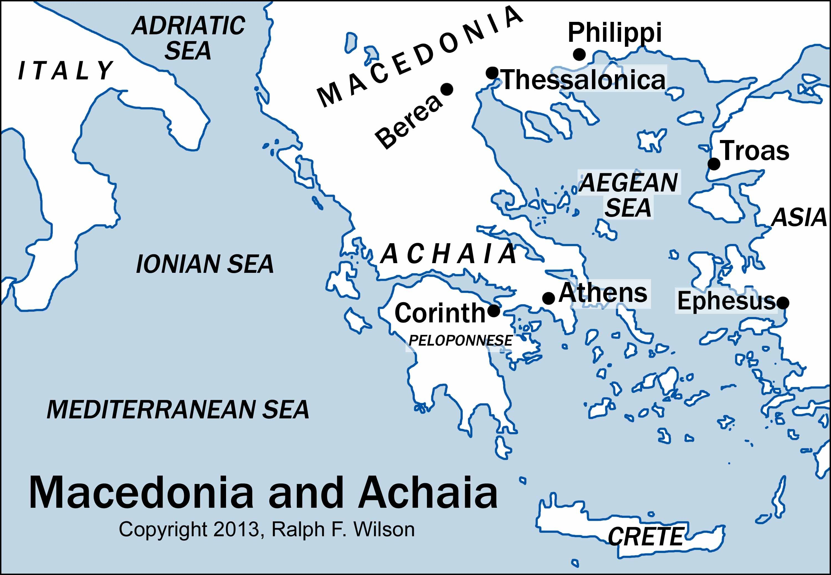
How They Became Affluent
Centrally and Strategically located

Slide 21
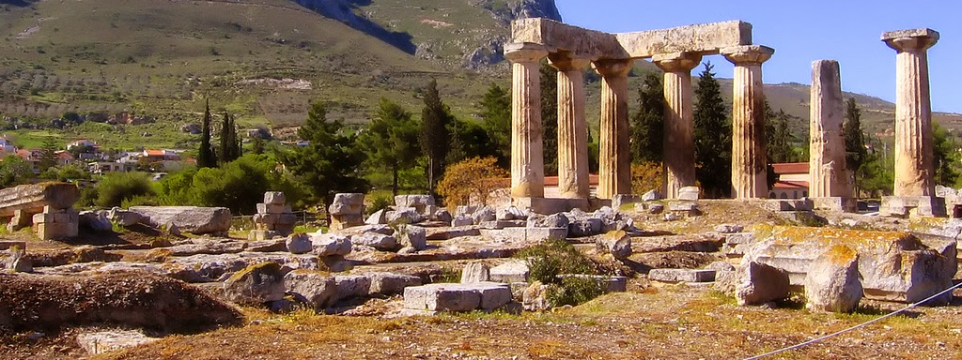
The Church of Corinth Today
What happened ?

Slide 22
Paul’s Admonishment
They had problem with their eyes. They were fixed on externals

Slide 23
The world’s limelight shines on successful people. Its yardstick for success is often focused on our affluence or acquisitions (what we have), our associations (who we know), our appearance (how we look), our abilities (what we can do) and our accomplishments (what we have done). These are external and temporal measure.
Pastor Edmund Chan – Mentoring Paradigms (Page 28)

Slide 24
Developing your Inner Life
Developing integrity, character and surrender to God
Ps Edmund Chan

Slide 25
The Condition of the Leaders
Look like “Fools” in public eyes
Weak and poor (in rags)
Hungry and homeless
Worked hard with own hands
Brutally treated, persecuted, cursed, slandered
Like scums of the earth and garbage
Endured hardship

Slide 26
2 Cor 4 : 8-10, 16-18
⁸ We are hard pressed on every side, but not crushed; perplexed, but not in despair; ⁹ persecuted, but not abandoned; struck down, but not destroyed. ¹⁰ We always carry around in our body the death of Jesus …..
¹⁶ Though outwardly we are wasting away, yet inwardly we are being renewed day by day. ¹⁷ For our light and momentary troubles are achieving for us an eternal glory that far outweighs them all. ¹⁸ So we fix our eyes not on what is seen, but on what is unseen, since what is seen is temporary, but what is unseen is eternal

Slide 27
The Bitter Sweet Experiences of a Leader

Slide 28
A True Leader is a Father
I am writing this not to shame you but to warn you as my dear children

Slide 29
A Father
Takes responsibility for his child

Slide 30
He Fathers his Children
I have sent to you Timothy, my son ….He will remind you of my way of life

Slide 31
Imitate me
For to me, to live is Christ and to die is gain (Phil 1:21)

Slide 32
Final Exhortation (for Leaders)
Focus on the being… The best gift we can give to our members is to live a Jesus-Centered life

Slide 33
Final Exhortation (For Church)
Have confidence in your leaders and submit to their authority, because they keep watch over you as those who must give an account. Do this so that their work will be a joy, not a burden, for that would be of no benefit to you.
Hebrews 13:17

