Slide 1

Flee
From
Sexual
Immorality
I Corinthians 6:12-20

Slide 2

I Vv. 12-17 Paul was
dealing with Christians
who had a faulty idea
of FREEDOM
and the wrong use
of their BODIES.

Slide 3

I A. Their ARGUMENTS
were simplistic and shallow
influenced by three issues
CONNECTED with
life in Corinth.

Slide 4

1) GREEK philosophy taught
"one's spirit is good
but the flesh is bad;"
the body could be abused
with no consequence
to the spirit.

Slide 5
2) Christians were
indulging
their bodies
and claiming that
it did not MATTER.

Slide 6
3) There was a temple
to the goddess
of love;
hundreds of
prostitutes
were AVAILABLE.
.

Slide 7

I B. A quick overview
of the PROGRESSION
of Paul's arguments
with the Corinthians
so far.

Slide 8
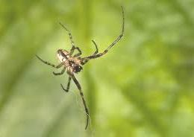
Paul had DISMANTLED
the shallow arguments
of the Corinthians to justify
their sexual immorality then;
we have to be aware of
enticing trends used today!

Slide 9
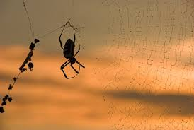
II Vv. 18-20 are Paul's
CALL and
THOUGHTS
on how to honour God
with our bodies.

Slide 10

II A. Not only did Paul
say to FLEE
from sexual sins
he also explained
WHY.

Slide 11
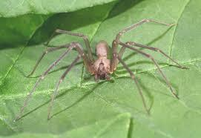
1st, the call to flee...
was designed to
COUNTER
the powerful pull
for Christians to indulge
their bodies in sexual sins.

Slide 12

2nd, Paul gave them
an understanding
of the NEED
to honour their bodies
because they have become
a temple of the Holy Spirit.

Slide 13
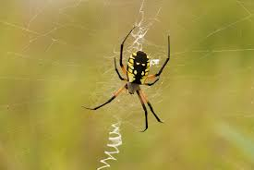
II B. We need to understand
what Paul
MEANT
by that statement.

Slide 14

1) Because of Christ's
bodily resurrection
and ours promised,
2) and God has put
his Holy Spirit in us,
we must HONOUR
our physical bodies.

Slide 15
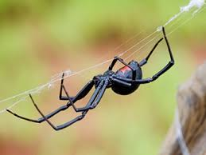
III Application.

Slide 16
IIIA. There is no excuse
for any Christians
not to understand
that indulging the body
in sexual immorality
is a SERIOUS sin.

Slide 17
Living in this
sinful world
we are often TEMPTED
to drop our standards
and compromise.

Slide 18

III B. There is also no excuse
to REMAIN
in some form
of sexual sin;
although you may feel
trapped in it.

Slide 19
The Holy Spirit
is the spiritual
RESOURCE
to both guide and
empower you
to set you free.

