Slide 1
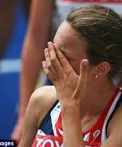
Disqualified
1 Corinthians 9:24 – 10:13

Slide 2
1 Corinthians 9
²⁴ Do you not know that in a race all the runners run, but only one gets the prize? Run in such a way as to get the prize. ²⁵ Everyone who competes in the games goes into strict training. They do it to get a crown that will not last, but we do it to get a crown that will last forever. ²⁶ Therefore I do not run like someone running aimlessly; I do not fight like a boxer beating the air. ²⁷ No, I strike a blow to my body and make it my slave so that after I have preached to others, I myself will not be disqualified for the prize.

Slide 3
1 Corinthians 10:1-5
For I do not want you to be ignorant of the fact, brothers and sisters, that our ancestors were all under the cloud and that they all passed through the sea. ² They were all baptized into Moses in the cloud and in the sea. ³ They all ate the same spiritual food ⁴ and drank the same spiritual drink; for they drank from the spiritual rock that accompanied them, and that rock was Christ. ⁵ Nevertheless, God was not pleased with most of them; their bodies were scattered in the wilderness.

Slide 4
1 Corinthians 10:6-10
Now these things occurred as examples to keep us from setting our hearts on evil things as they did. ⁷ Do not be idolaters, as some of them were; as it is written: “The people sat down to eat and drink and got up to indulge in revelry.”^{[a]} ⁸ We should not commit sexual immorality, as some of them did—and in one day twenty-three thousand of them died. ⁹ We should not test Christ,^{[b]} as some of them did—and were killed by snakes. ¹⁰ And do not grumble, as some of them did—and were killed by the destroying angel.

Slide 5
1 Corinthians 10:11-13
¹¹ These things happened to them as examples and were written down as warnings for us, on whom the culmination of the ages has come. ¹² So, if you think you are standing firm, be careful that you don’t fall! ¹³ No temptation^{[c]} has overtaken you except what is common to mankind. And God is faithful; he will not let you be tempted^{[d]} beyond what you can bear. But when you are tempted,^{[e]} he will also provide a way out so that you can endure it.

Slide 6
Disqualified
1 Corinthians 9:24 – 10:13

Slide 7
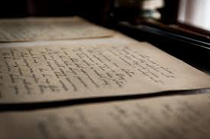
A letter from a Father to his Children

Slide 8

The Church was not doing well
Division
Sexual immorality
Lawsuits

Slide 9
Paul’s counsel
Be careful however that the exercise of your rights does not become a stumbling block to the weak
1 Cor 8:9

Slide 10
Paul’s example of using his rights
Though I am free and belong to no one, I have made myself a slave to everyone to win as many as possible… To the weak I became weak, I have become all things to all people so that by all possible means I might save some. I do this for the sake of the gospel so that I may share in its blessings
1 Cor 9:19,22

Slide 11
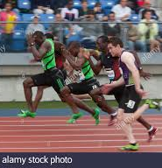
Using a race as an example
²⁴ Do you not know that in a race all the runners run, but only one gets the prize? Run in such a way as to get the prize.
1 Cor 9:24

Slide 12
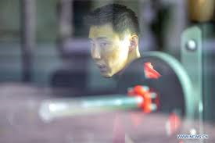
Training
Everyone who competes in the games goes into strict training.

Slide 13
Sin is an action that begins from the heart
A liar is not just a person who lied but also person who would lie when given an opportunity, likewise with an adulterer, a thief, etc

Slide 14

Training VS Trying
Training involves…
Conviction (must want to)
Commitment
Plan
Practice and perseverance

Slide 15
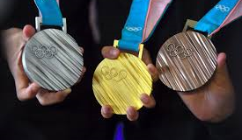
Crown that will not last
They (Athletes) do it to get a crown that will not last, but we do it to get a crown that will last forever.

Slide 16

Crown that will last forever
Our relationships with God
Our inner character
Works done with God

Slide 17
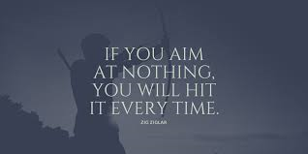
ZIG ZIGLAR
Therefore I do not run like someone running aimlessly; I do not fight like a boxer beating the air.

Slide 18
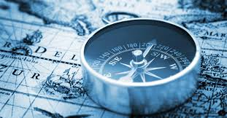
What drives you?
A question of life’s purpose, direction and orientation

Slide 19
What drove Paul
He orientates his life to knowing Christ (Phil 3:10) and making him known
I strike a blow to my body and make it my slave so that after I have preached (the gospel) to others, I myself will not be disqualified for the prize

Slide 20
Was Paul talking about losing his salvation?
I strike a blow to my body and make it my slave so that after I have preached (the gospel) to others, I myself will not be disqualified for the prize

Slide 21
1 Corinthians 10:1-5
For I do not want you to be ignorant of the fact, brothers and sisters, that our ancestors were all under the cloud and that they all passed through the sea. ² They were all baptized into Moses in the cloud and in the sea. ³ They all ate the same spiritual food ⁴ and drank the same spiritual drink; for they drank from the spiritual rock that accompanied them, and that rock was Christ. ⁵ Nevertheless, God was not pleased with most of them; their bodies were scattered in the wilderness.

Slide 22
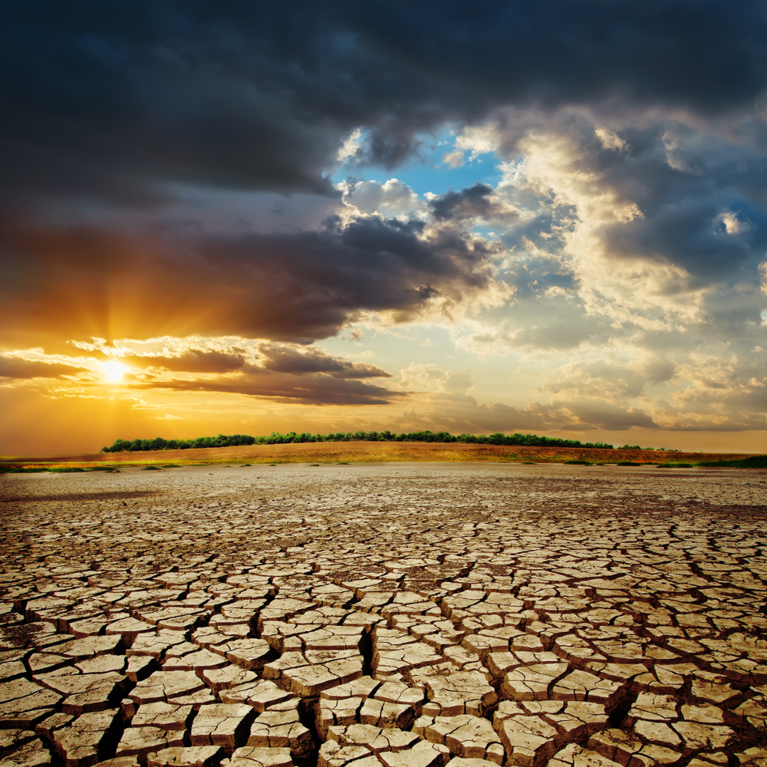
A reminder about the Past
Many didn’t enter the promised land except Joshua and Caleb (Exodus, Numbers)

Slide 23
Now these things occurred as examples to keep us from setting our hearts on evil things as they did. ⁷ Do not be idolaters, as some of them were; as it is written: “The people sat down to eat and drink and got up to indulge in revelry.”^{[a]} ⁸ We should not commit sexual immorality, as some of them did—and in one day twenty-three thousand of them died. ⁹ We should not test Christ,^{[b]} as some of them did—and were killed by snakes. ¹⁰ And do not grumble, as some of them did—and were killed by the destroying angel.

Slide 24
Lesson from History
Examples to keep us from setting our hearts on evil things as they did
1 Cor 10:6
They worshipped idols
They ate, drink and indulged in revelry
They had illicit sex
They grumbled and murmured (did not trust God, showed contempt)

Slide 25
Why would it matter if we do not have a relationship with God and do not live our lives for Him right now?
So, does “disqualified for the price” mean losing salvation?

Slide 26
¹¹ These things happened to them as examples and were written down as warnings for us, on whom the culmination of the ages has come. ¹² So, if you think you are standing firm, be careful that you don’t fall! ¹³ No temptation^{[c]} has overtaken you except what is common to mankind. And God is faithful; he will not let you be tempted^{[d]} beyond what you can bear. But when you are tempted,^{[e]} he will also provide a way out so that you can endure it.

Slide 27

The End is Near
1 Cor 10:11

Slide 28
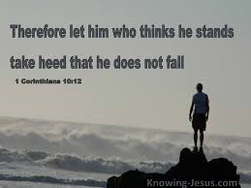
Don’t be naïve and self-confident, we are just as capable of messing it up as they were
Eugene Peterson
Message Bible

Slide 29
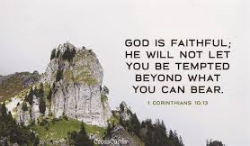
No test or temptation that comes your way is beyond the course of what others have had to face. All you need to remember is that God will never let you down; he’ll never let you be pushed past your limit; he’ll always be there to help you come through it
1 Cor 10:13 - MSG
Assurance of Help from God

