Slide 1
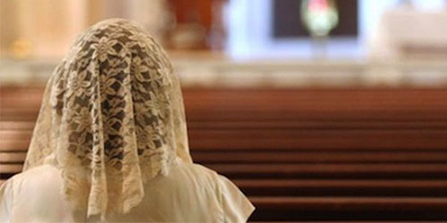
HEADSHIP
1 Corinthians 11:2-16

Slide 2
1 Corinthians 11
² I praise you for remembering me in everything and for holding to the traditions just as I passed them on to you. ³ But I want you to realise that the head of every man is Christ, and the head of the woman is man, and the head of Christ is God. ⁴ Every man who prays or prophesies with his head covered dishonours his head. ⁵ But every woman who prays or prophesies with her head uncovered dishonours her head – it is the same as having her head shaved. ⁶ For if a woman does not cover her head, she might as well have her hair cut off; but if it is a disgrace for a woman to have her hair cut off or her head shaved, then she should cover her head.
⁷ A man ought not to cover his head, since he is the image and glory of God; but woman is the glory of man. ⁸ For man did not come from woman, but woman from man; ⁹ neither was man created for woman, but woman for man.

Slide 3
1 Corinthians 11
¹⁰ It is for this reason that a woman ought to have authority over her own head, because of the angels. ¹¹ Nevertheless, in the Lord woman is not independent of man, nor is man independent of woman. ¹² For as woman came from man, so also man is born of woman. But everything comes from God.
¹³ Judge for yourselves: is it proper for a woman to pray to God with her head uncovered? ¹⁴ Does not the very nature of things teach you that if a man has long hair, it is a disgrace to him, ¹⁵ but that if a woman has long hair, it is her glory? For long hair is given to her as a covering. ¹⁶ If anyone wants to be contentious about this, we have no other practice – nor do the churches of God.

Slide 4
Public Worship
Conduct of Women In Worship
Administration of The Lord’s Supper
Use of The Gifts of The Holy Spirit

Slide 5

² I praise you for remembering me in everything and for holding to the traditions just as I passed them on to you. (1 Corinthians 11)

Slide 6

Difficult Passage

Slide 7

Of Lesser Worth?

Slide 8
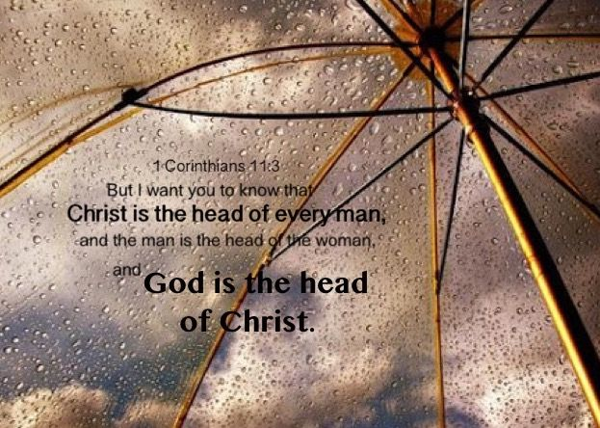
Understanding Headship
Lead
Submit

Slide 9

The Head of Every Man Is Christ
¹⁰ that at the name of Jesus every knee should bow, in heaven and on earth and under the earth, ¹¹ and every tongue acknowledge that Jesus Christ is Lord, to the glory of God the Father. (Philippians 2)
¹¹ It is written: “‘As surely as I live,’ says the Lord, ‘every knee will bow before me; every tongue will acknowledge God.’” (Romans 14)

Slide 10

The Head of Christ Is God
“I and the Father are one.” (John 10:30)
⁶ who, although He existed in the form of God, did not regard equality with God a thing to be grasped, ⁷ but emptied Himself taking the form of a bond-servant, and being made in the likeness of men. ⁸ Being found in appearance as a man, He humbled Himself by becoming obedient to the point of death, even death on a cross.
(Philippians 2)

Slide 11

The Head of Christ Is God
“My food,” said Jesus, “is to do the will of him who sent me and to finish his work.” (John 4:34)
“The one who sent me is with me; he has not left me alone, for I always do what pleases him.” (John 8:29)

Slide 12
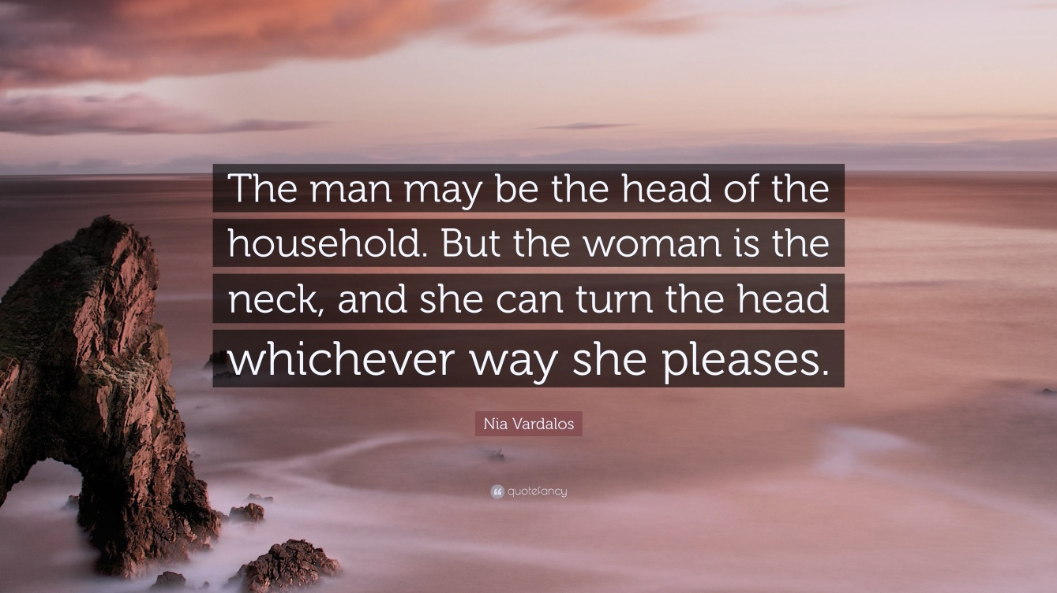
The Head of The Woman Is Man
God-Given Responsibility
Voluntary Submission

Slide 13
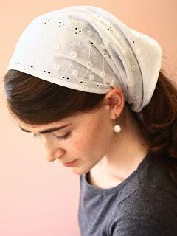
Head Covering
⁴ Every man who prays or prophesies with his head covered dishonours his head. ⁵ But every woman who prays or prophesies with her head uncovered dishonours her head – it is the same as having her head shaved. ⁶ For if a woman does not cover her head, she might as well have her hair cut off; but if it is a disgrace for a woman to have her hair cut off or her head shaved, then she should cover her head.
(1 Corinthians 11)

Slide 14
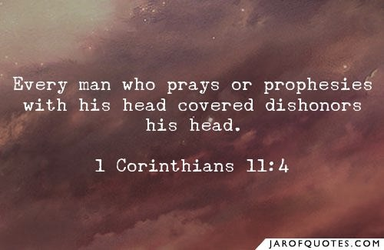
Dishonouring His Head

Slide 15
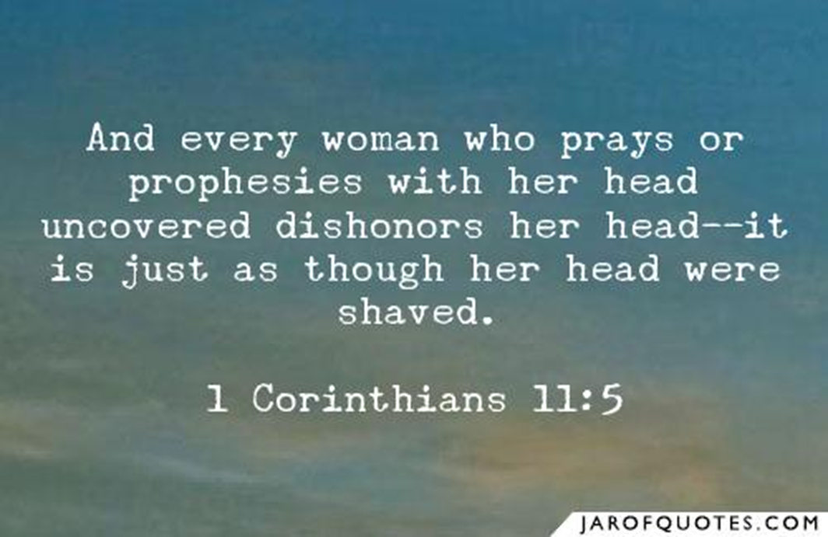
Dishonouring Her head
⁶ For if a woman does not cover her head, she might as well have her hair cut off; but if it is a disgrace for a woman to have her hair cut off or her head shaved, then she should cover her head. (1 Corinthians 11)

Slide 16

… if a woman does not have a covering (in this 1st century Christian setting) she dishonors her head, her husband. The reason for that was dramatically obvious in Corinth. In this city, the most licentious city of the 1st century, the only women who did not wear a veil were the temple prostitutes. Any woman, therefore, who appeared on the public streets without a veil was opening herself up to the suspicion that she was available to any man who wanted to pay the price, that she was nothing more than a temple prostitute. It was indeed disgraceful, shameful, for a woman to appear in public, and especially to minister the Word in a Christian assembly, without that sign of acknowledgment of the principle of headship in her life. (Ray Stedman, “What Is Headship?”)

Slide 17

Respecting The Principle of Headship
⁷ A man ought not to cover his head, since he is the image and glory of God; but woman is the glory of man. ⁸ For man did not come from woman, but woman from man; ⁹ neither was man created for woman, but woman for man. ¹⁰ It is for this reason that a woman ought to have authority over her own head, because of the angels. ¹¹ Nevertheless, in the Lord woman is not independent of man, nor is man independent of woman. ¹² For as woman came from man, so also man is born of woman. But everything comes from God. (1 Corinthians 11)

Slide 18
The Order of Creation
⁷ … he is the image and glory of God; but woman is the glory of man. ⁸ For man did not come from woman, but woman from man; ⁹ neither was man created for woman, but woman for man.
(1 Corinthians 11)
… when man was created, he was made to reflect the nature of God, and, in that, God takes great delight. He delights in mankind and this is what the male is to represent. That glory of God is to be publicly and openly manifested and that is why the man must not wear a veil. He is not to cover God's creative glory. He is to be unveiled so that the glory of God in creation should be visibly manifest to everyone.
(Ray Stedman, “What Is Headship?”)

Slide 19
The Order of Creation
But the woman is the glory of the man, created for the honour of the man, and for his help and assistance, and originally made out of man, so as man may glory of her, as Adam did of Eve.
Adam was not created for Eve, but Eve was created for Adam – and this principle applies to every “Adam” and every “Eve” through history. Genesis 2:18 declares God’s intention in creating Eve: I will make him a helper comparable to him. Eve was created to be a helper to Adam, meaning that Adam was “head” over Eve, and she was called to share and help his vision and agenda. Genesis 2:22 says, He brought her to the man. Adam was not brought to Eve, but Eve was brought to Adam – her head. It is an idea offensive to the spirit of our age, but the Bible in this passage clearly teaches that (in the church and in the home) man was not made for the benefit of woman, but woman for the benefit of man.
(David Guzik, “Concerning Women & The Lord’s Supper”)

Slide 20
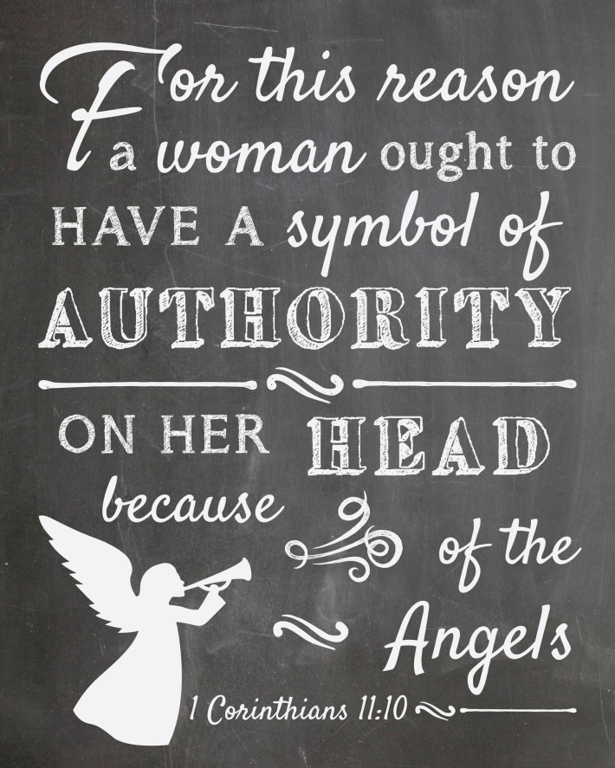
Because of The Angels
In a culture where unveiled women were regarded as idolators and prostitutes, it would be offensive for a woman to openly flaunt custom and deny the principle of headship.
(Ray Stedman, “What Is Headship?)

Slide 21
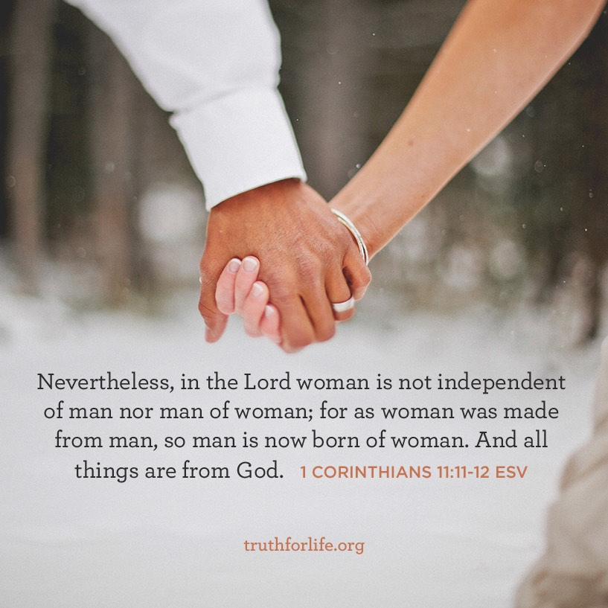
Interdependence
They are equal as persons, distinct as sexes, functioning in a divinely given order which is to be freely accepted by the woman, in order to demonstrate to all the delight of God in his creation and redemption of mankind. If we will carefully think that through we shall find it is a very powerful argument for equality of persons and distinctiveness of roles.
(Ray Stedman, “What Is Headship?”)

Slide 22
Judge For Yourselves
¹³ Judge for yourselves: is it proper for a woman to pray to God with her head uncovered? ¹⁴ Does not the very nature of things teach you that if a man has long hair, it is a disgrace to him, ¹⁵ but that if a woman has long hair, it is her glory? For long hair is given to her as a covering. ¹⁶ If anyone wants to be contentious about this, we have no other practice – nor do the churches of God. (1 Corinthians 11)

Slide 23
Is Head Covering A Must Today?
No! Why not? Because head-covering does not mean in our culture what it did then. The absence of it then identified a woman as immoral and disrupted the church. The absence of head-covering does not do either of these things today. In other words, we have to distinguish between what is culturally dated and what is eternally valid. The head covering was culturally dated, but the principle of man’s headship is eternally valid.
(Welwyn Commentary Series – Strengthening Christ’s Church: The Message of 1 Corinthians)

Slide 24

Submission & Respect
Man
Woman

Slide 25

God-Honouring Worship
¹ Guard your steps when you go to the house of God. Go near to listen rather than to offer the sacrifice of fools, who do not know that they do wrong. (Ecclesiastes 5)

