Slide 1


Luke 15:11-24

Slide 2
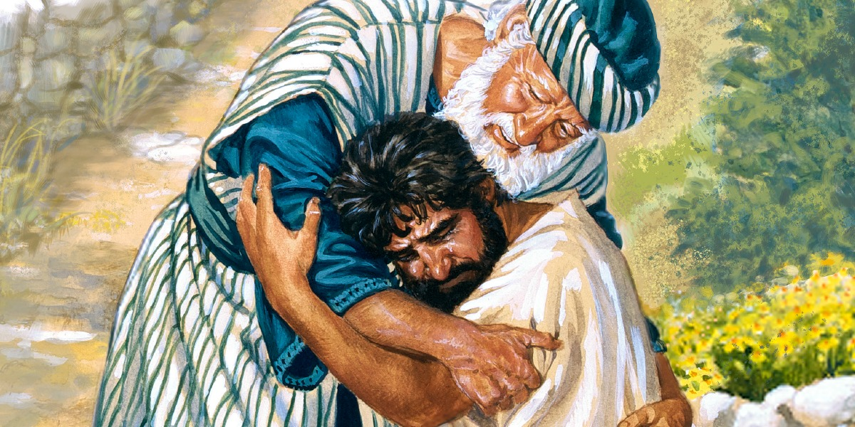
The Parable of the Prodigal Son
“This man welcomes sinners and eats with them.” V2

Slide 3
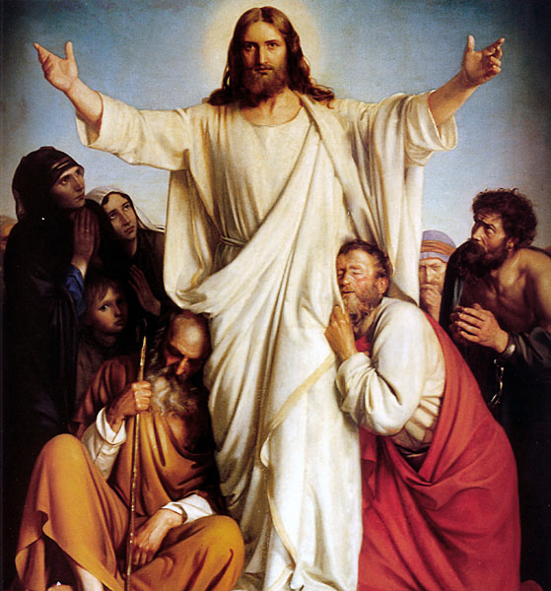
Jesus Reveals the Father
“Anyone who has seen me has seen the Father.” Jn 14:9

Slide 4

Jesus Reveals the Father
“Our Father in Heaven, hallowed be your name.” Mt 6:9

Slide 5

Jesus Reveals the Father
The Spirit you received brought about your adoption. And by Him we cry ‘Abba Father.’ Jn 14:9

Slide 6

A Good and Loving Father?

Slide 7
The Father of Israel
When Israel was a child, I loved him, and out of Egypt I called my son… It was I who taught Ephraim to walk, taking them by the arms; but they did not realize it was I who healed them. I led them with cords of human kindness, with ties of love. To them I was like one who lifts a little child to the cheek, and I bent down to feed them. (Hosea 11:1,3-4)

Slide 8
The Father of Israel
The Lord your God, who is going before you, will fight for you, as he did for you in Egypt, before your very eyes, and in the wilderness. There you saw how the Lord your God carried you, as a father carries his son, all the way you went until you reached this place. (Deut. 1:30-31)

Slide 9
The Father of Israel
You yourselves have seen what I did to Egypt, and how I carried you on eagles’ wings and brought you to myself. (Ex 19:4)

Slide 10
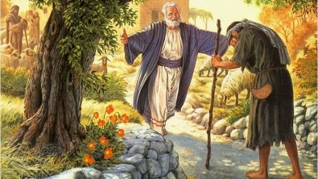
The Father and the Prodigal Son

Slide 11

Know the Lord God as Your Father

