Slide 1
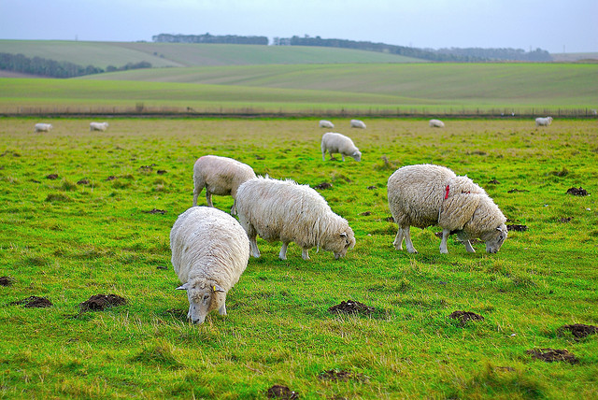
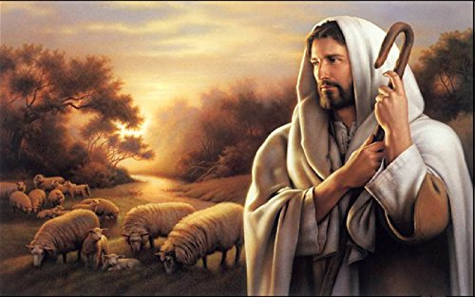
Jesus Our Good Shepherd
Jn 10:1-15
Know Him, Hear from Him and Walk with Him

Slide 2
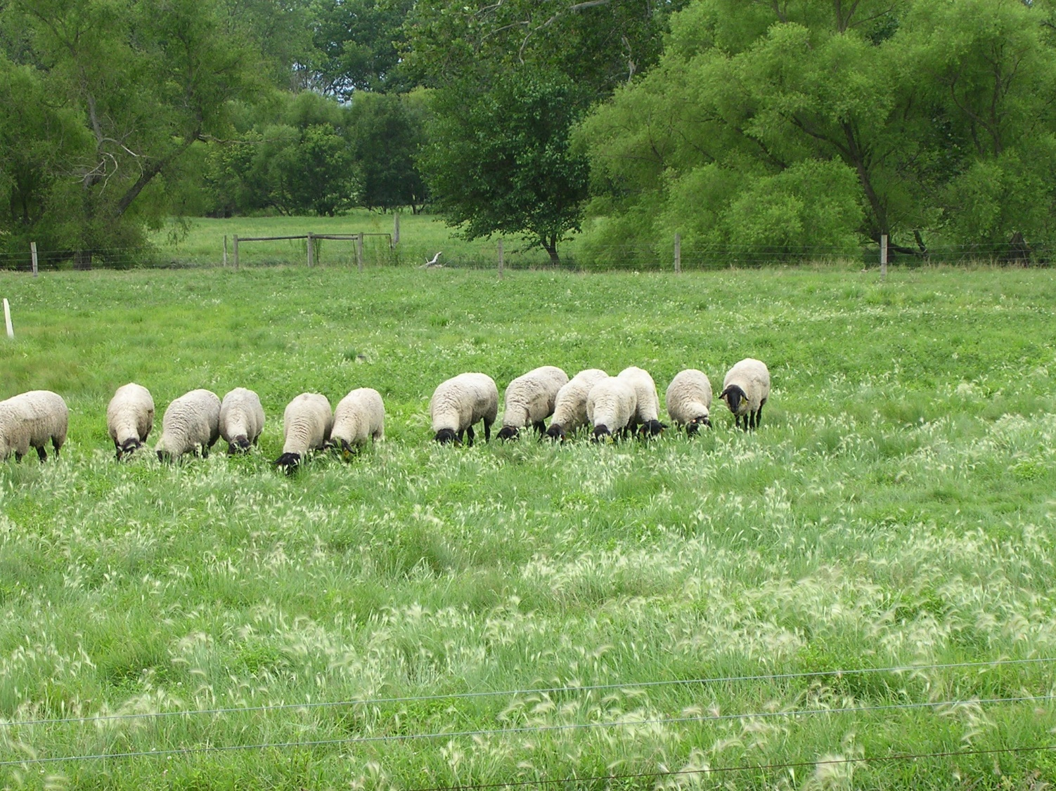
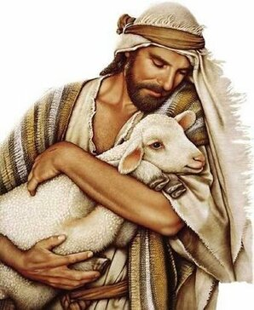
The Lord is My Shepherd Ps 23:1
He tends his flock like a shepherd: He gathers the lambs in his arms and carries them close to his heart; he gently leads those that have young. Is 40:11

Slide 3
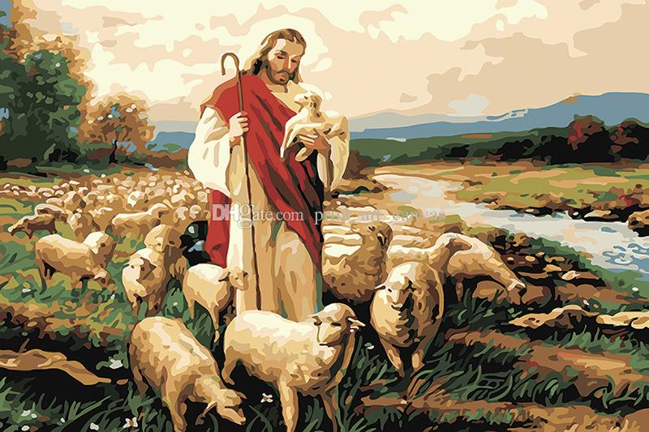
I will place over them one shepherd, my servant David, and he will tend them; he will tend them and be their shepherd. Ezk 34:23

Slide 4
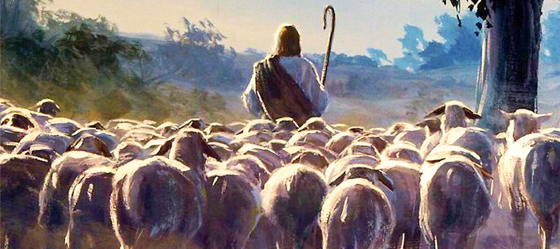
Jesus is the Good Shepherd
“I am the good shepherd. The good shepherd lays down his life for the sheep.” Jn 10:11

Slide 5
Let Us Know the Shepherd
“I am the good shepherd; I know my sheep and my sheep know me.” Jn 10:14

Slide 6
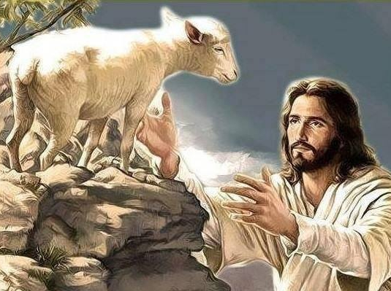
Let Us Hear the Shepherd’s Voice
His sheep follow Him because they know His voice. Jn 10:4

Slide 7
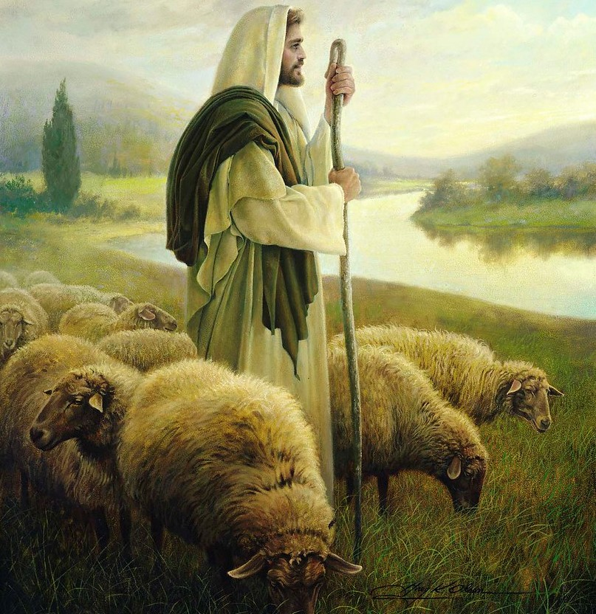
Let Us Walk with the Shepherd
When he has brought out all his own, he goes on ahead of them, and his sheep follow him. Jn 10:4

Slide 8
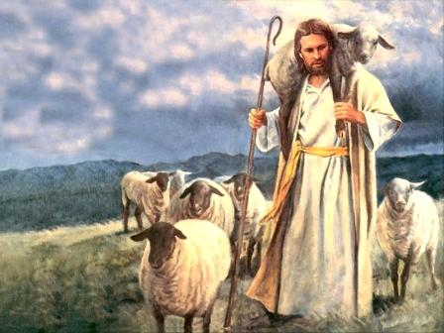
KNOW HEAR WALK
THE GOOD SHEPHERD

