Slide 1
Spiritual Gifts
1 Corinthians 12:1-11 (NRSV)

Slide 2
12 Now concerning spiritual gifts,^{[a]} brothers and sisters,^{[b]} I do not want you to be uninformed. ² You know that when you were pagans, you were enticed and led astray to idols that could not speak. ³ Therefore I want you to understand that no one speaking by the Spirit of God ever says “Let Jesus be cursed!” and no one can say “Jesus is Lord” except by the Holy Spirit.

Slide 3
⁴ Now there are varieties of gifts, but the same Spirit; ⁵ and there are varieties of services, but the same Lord; ⁶ and there are varieties of activities, but it is the same God who activates all of them in everyone. ⁷ To each is given the manifestation of the Spirit for the common good.

Slide 4
⁸ To one is given through the Spirit the utterance of wisdom, and to another the utterance of knowledge according to the same Spirit, ⁹ to another faith by the same Spirit, to another gifts of healing by the one Spirit, ¹⁰ to another the working of miracles, to another prophecy, to another the discernment of spirits, to another various kinds of tongues, to another the interpretation of tongues.

Slide 5
¹¹ All these are activated by one and the same Spirit, who allots to each one individually just as the Spirit chooses.

Slide 6
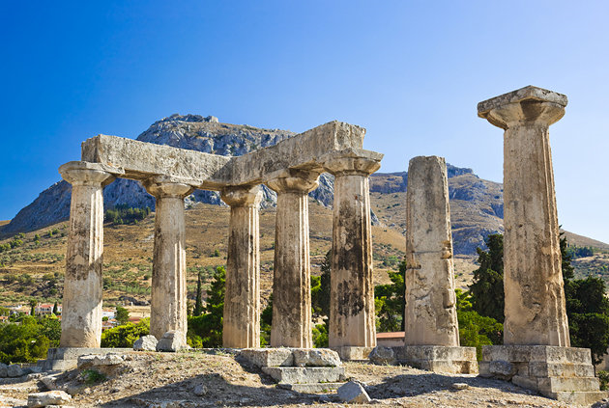
The Background
CHURCH OF CORINTH
A spiritually gifted church (1 Cor 1:7), but had problems with misuse and abuse of spiritual gifts (1 Cor 12:2-3, 14)

Slide 7

A Young Church
12 Now concerning spiritual gifts,^{[a]} brothers and sisters,^{[b]} I do not want you to be uninformed.

Slide 8
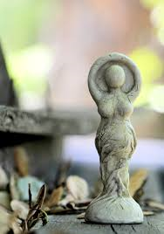
Believer’s Pagan Background
² You know that when you were pagans, you were enticed and led astray to idols that could not speak.

Slide 9
This is how you know ..
³ Therefore I want you to understand that no one speaking by the Spirit of God ever says “Let Jesus be cursed!” and no one can say “Jesus is Lord” except by the Holy Spirit.

Slide 10
⁴ Now there are varieties of gifts, but the same Spirit; ⁵ and there are varieties of services, but the same Lord; ⁶ and there are varieties of activities, but it is the same God who activates all of them in everyone. ⁷ To each is given the manifestation of the Spirit for the common good.

Slide 11
What spiritual gifts are not
Spiritual gifts are not at all similar to the presents we received from our loved ones during birthday or Christmas

Slide 12
Definition
Spiritual gifts are the Holy Spirit himself, manifesting in and through us to accomplish his works.

Slide 13
A story was once told about the 4 Maidens and a Prince..

Slide 14
Take not thy Holy Spirit from me
David
Psalm 51:11

Slide 15
If you then, though you are evil, know how to give good gifts to your children, how much more will your Father in heaven give the Holy Spirit to those who ask him!“
Luke 11:13

Slide 16
Spiritual Gifts are the Holy Spirit himself coming to various degrees of manifestation in and through ordinary Christians to draw them into greater fellowship with him and greater conformity to Christ.
Sam Storms
Author, beginner’s guide to Spiritual Gifts

Slide 17
Holy Spirit is unbodily, person and power
Dallas Willard

Slide 18
⁴ There are varieties of gifts (manifestations), but the same Spirit.

Slide 19
Varieties of Spiritual Gifts
1 Corinthians 12
Romans 12
Eph 4
Wisdom
Knowledge
Faith
Healing
Miraculous Power
Prophecy
Discernment
Speaking in tongues
Interpretation of tongues
Apostles
Prophets
Teachers
Help
Prophecy
Faith
Service
Teaching
Encouragement
Giving
Leading
Mercy
Apostles
Prophets
Evangelists
Pastors
Teachers

Slide 20
⁵ and there are varieties of services (ministries), but the same Lord;

Slide 21
⁷ But to each one of us grace has been given as Christ apportioned it … ¹¹ So Christ himself gave the apostles, the prophets, the evangelists, the pastors and teachers, ¹² to equip his people for works of service, so that the body of Christ may be built up.
(Ephesians 4:7,11-12)

Slide 22
⁶ and there are varieties of activities, but it is the same God who activates all of them in everyone.

Slide 23
⁴ For just as each of us has one body with many members, and these members do not all have the same function, ⁵ so in Christ we, though many, form one body, and each member belongs to all the others. ⁶ We have different gifts, according to the grace given to each of us. If your gift is prophesying, then prophesy in accordance with your^{[a]} faith; ⁷ if it is serving, then serve; if it is teaching, then teach; ⁸ if it is to encourage, then give encouragement; if it is giving, then give generously; if it is to lead,^{[b]} do it diligently; if it is to show mercy, do it cheerfully.
(Romans 12:4-8)

Slide 24
⁷ Now to each one the manifestation of the Spirit is given for the common good..

Slide 25
⁷ To each one the manifestation of the Spirit is given for the common good.

Slide 26
The gifts of the Spirit are not medals of honour for display, they are tools for different jobs . This is how it works… When God gives me a job to do, He will give me the exact tool I need to do the job for that moment. Today it may be to heal the sick, tomorrow it may be to raise the dead. The gifts are not given for us to possess, but God gives the right gifts at the right time to get His job done.
Reinhard Bonkke, Evangelist

Slide 27
In Closing
You can’t go to school to receive spiritual gifts. You go to the Holy Spirit.
You need to have a relationship with the Spirit. We need to walk with him, listen to him and obey him.
It is through the daily walk that the Spirit manifests his gifts through you to accomplish his works.

