Slide 1
Eternal Security
Revelation 20:11-15
29th March 2020

Slide 2
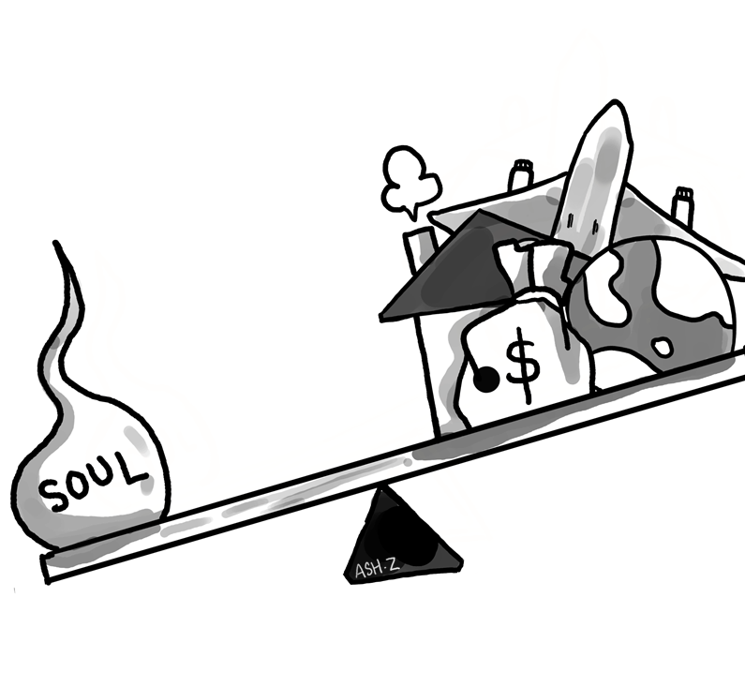
The Worth of Human Soul
Matthew 16:26 (NIV)
²⁶ What good will it be for someone to gain the whole world, yet forfeit their soul? Or what can anyone give in exchange for their soul?

Slide 3
²³ Above all else, guard your heart,
for everything you do flows from it.
Proverbs 4:23 (NIV)

Slide 4
¹⁷ Obey your leaders and submit to them, for they are keeping watch over your souls, as those who will have to give an account.
Hebrews 13:17 (ESV)

Slide 5
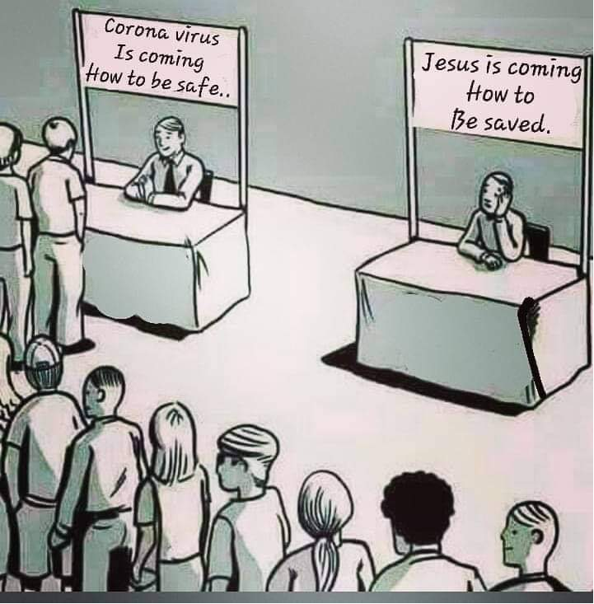

Slide 6
⁴ “I tell you, my friends, do not be afraid of those who kill the body and after that can do no more. ⁵ But I will show you whom you should fear: Fear him who, after your body has been killed, has authority to throw you into hell. Yes, I tell you, fear him.
Luke 12:4-5 (NIV)

Slide 7
¹¹ Then I saw a great white throne and him who was seated on it. The earth and the heavens fled from his presence, and there was no place for them. ¹² And I saw the dead, great and small, standing before the throne, and books were opened. Another book was opened, which is the book of life. The dead were judged according to what they had done as recorded in the books. ¹³ The sea gave up the dead that were in it, and death and Hades gave up the dead that were in them, and each person was judged according to what they had done. ¹⁴ Then death and Hades were thrown into the lake of fire. The lake of fire is the second death. ¹⁵ Anyone whose name was not found written in the book of life was thrown into the lake of fire.
Revelation 20:11-15 (NIV)

Slide 8
⁹ Or do you not know that wrongdoers will not inherit the kingdom of God? Do not be deceived: Neither the sexually immoral nor idolaters nor adulterers nor men who have sex with men^{[a]} ¹⁰ nor thieves nor the greedy nor drunkards nor slanderers nor swindlers will inherit the kingdom of God.
1 Corinthians 6:9-10 (NIV)

Slide 9
Then I saw a Great White Throne and him who was seated on it.
Revelation 20:11a (NIV)

Slide 10
Lebanon is not sufficient for altar fires, nor its animals enough for burnt offerings
Isaiah 40:16 (NIV)

Slide 11
Who has measured the waters in the hollow of his hand, or with the breadth of his hand marked off the heavens? Who has held the dust of the earth in a basket, or weighed the mountains on the scales and the hills in a balance?
Isaiah 40:12 (NIV)

Slide 12
⁴ And I saw thrones, and they sat upon them, and judgment was given unto them: and I saw the souls of them that were beheaded for the witness of Jesus, and for the word of God, and which had not worshipped the beast, neither his image, neither had received his mark upon their foreheads, or in their hands; and they lived and reigned with Christ a thousand years.
Revelation 20:4 (NIV)

Slide 13
The earth and the heavens fled from his presence, and there was no place for them.
Revelation 20:11b (NIV)

Slide 14
¹² And I saw the dead, great and small, standing before the throne, and books were opened.
Revelation 20:12a (NIV)

Slide 15
and with you, Lord, is unfailing love"; and, "You reward everyone according to what they have done."
Psalms 62:12 (NIV)

Slide 16
⁶ God “will repay each person according to what they have done.” ⁷ To those who by persistence in doing good seek glory, honor and immortality, he will give eternal life. ⁸ But for those who are self-seeking and who reject the truth and follow evil, there will be wrath and anger.
Romans 2:6-8 (NIV)

Slide 17
Another book was opened, which is the book of life. The dead were judged according to what they had done as recorded in the books.
Revelation 20:12 (NIV)

Slide 18
¹³ The sea gave up the dead that were in it, and death and Hades gave up the dead that were in them, and each person was judged according to what they had done.
Revelation 20:13 (NIV)

Slide 19
He is the atoning sacrifice for our sins, and not only for ours but also for the sins of the whole world.
1 John 2:2 (NIV)

Slide 20
¹⁴ Then death and Hades were thrown into the lake of fire. The lake of fire is the second death.
Revelation 20:14 (NIV)

Slide 21
¹⁵ Anyone whose name was not found written in the book of life was thrown into the lake of fire.
Revelation 20:15 (NIV)

